Slide 1
Measurement error correction with methods for two-phase designs
Doctoral qualifying exam
April 16th, 2024
Joshua Slone

Slide 2
Overview
Section 1: Background of KS study
Introduction
KS study
Section 2: Statistical methods for measurement error correction
Multiple imputation
Inverse probability weighting
Generalized raking
Section 3: KS in HIV observational clinic databases
Workflow
Example results
Section 4: Future work
Next steps

Slide 3
Section 1: Background of KS Study Issues of measurement error in observational data and how two-phase designs can help.

Slide 4
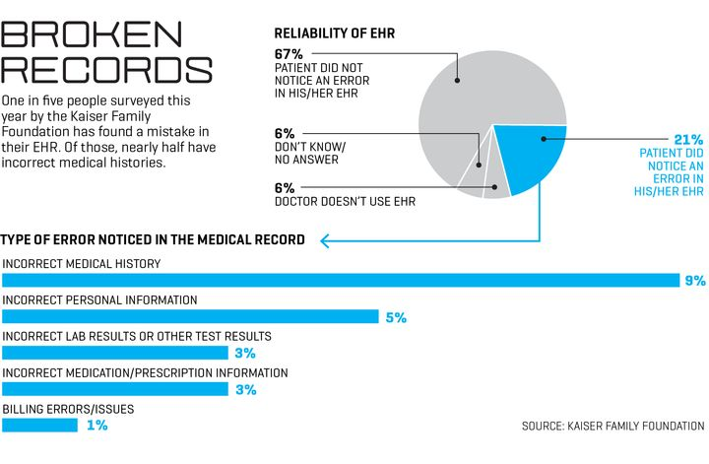
Section 1: Background - Issues that arise in the presence of measurement error
1.1 Introduction
Clinically relevant observational data is routinely collected in electronic health records (EHR)
Data extracted from EHR comes at a negligible cost but can be error prone, with correlated errors, e.g. date of lab value
Notes:
Duda, S. N., Shepherd, B. E., Gadd, C. S., Masys, D. R., and McGowan, C. C. (2012). Measuring the Quality of Observational Study Data in an International HIV Research Network. PLoS One. 7(4): e33908. DOI: 10.1371/journal.pone.0033908.
Giganti MJ, Shaw PA, Chen G, Bebawy SS, Turner MM, Sterling TR, Shepherd BE. ACCOUNTING FOR DEPENDENT ERRORS IN PREDICTORS AND TIME-TO-EVENT OUTCOMES USING ELECTRONIC HEALTH RECORDS, VALIDATION SAMPLES, AND MULTIPLE IMPUTATION. Ann Appl Stat. 2020 Jun;14(2):1045-1061. doi: 10.1214/20-aoas1343. Epub 2020 Jun 29. PMID: 32999698; PMCID: PMC7523695.
Fuller, W.A. (2009) Measurement error models, vol. 305. Hoboken: John Wiley & Sons.
Tao, R., Zeng, D., and Lin, D. Y. (2017). Efficient Semiparametric Inference Under Two-Phase Sampling, With Applications to Genetic Association Studies. Journal of the American Statistical Association, 112(520), 1468-1476. DOI: 10.1080/01621459.2017.1295864.

Slide 5
Section 1: Background - Issues that arise in the presence of measurement error
1.1 Introduction
Error-prone and missing data is common in observational studies
Several studies have explored the quality of HIV observational clinic data and have demonstrated the importance of data quality audits in obtaining accurate study findings (Kiragga et al., 2011; Duda et al., 2012; Mphatswe et al., 2012; Giganti et al., 2019; Lotspeich et al., 2020)
There are errors in all but one of the analysis variables in our study of Kaposi’s sarcoma (KS)
Notes:
White, J. E. (1982), A two stage design for the study of the relationship between a rare exposure and a rare disease, American Journal of Epidemiology 115(1), 119–128.

Slide 6
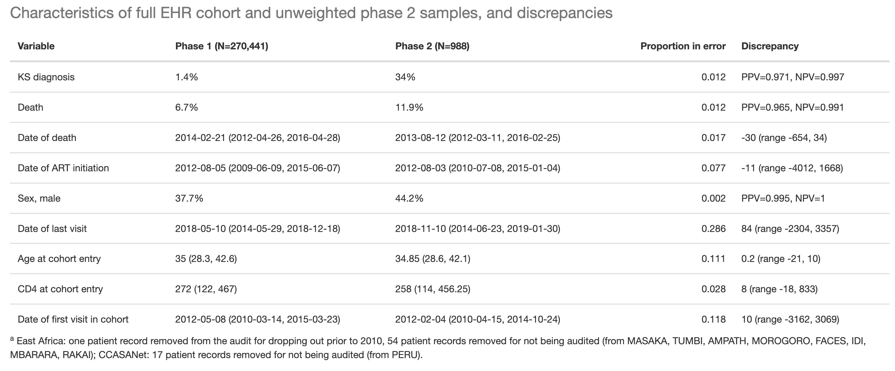
Section 1: Background - Issues that arise in the presence of measurement error
1.2 KS study: table of data quality
Notes:
White, J. E. (1982), A two stage design for the study of the relationship between a rare exposure and a rare disease, American Journal of Epidemiology 115(1), 119–128.

Slide 7
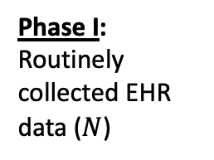
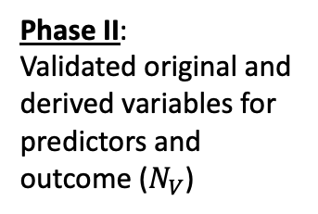
Section 1: Background - Issues that arise in the presence of measurement error
1.2 KS study: two-phase design
Goal: use measurement error correction methods with the data from the two-phase design for the KS study to efficiently and accurately determine the factors associated with KS
Phase I: Routinely collected EHR data ($N$)
Phase II:
Validated original and derived variables for predictors and outcome ($N_{V}$)
Notes:
White, J. E. (1982), A two stage design for the study of the relationship between a rare exposure and a rare disease, American Journal of Epidemiology 115(1), 119–128.

Slide 8
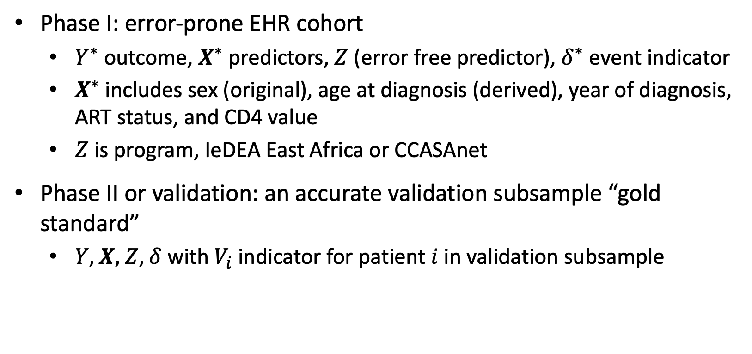
Section 1: Background - Issues that arise in the presence of measurement error
1.2 KS study: variables
Phase I: error-prone EHR cohort
$Y^{∗}$outcome, $X^{∗}$predictors, $Z$ (error free predictor), $δ^{∗}$ event indicator
$X^{∗}$includes sex (original), age at diagnosis (derived), year of diagnosis, ART status, and CD4 value
$Z$ is program, IeDEA East Africa or CCASAnet
Phase II or validation: an accurate validation subsample “gold standard”
$Y$, $X$, $Z$, $δ$ with $V_{i}$indicator for patient $i$ in validation subsample
Notes:
White, J. E. (1982), A two stage design for the study of the relationship between a rare exposure and a rare disease, American Journal of Epidemiology 115(1), 119–128.

Slide 9
Section 1: Background - Issues that arise in the presence of measurement error
1.2 KS study: analyses
Cox regression for factors associated with the survival outcome of time from KS diagnosis to death or censoring
Logistic regression for factors associated with the binary outcome of prevalence of KS at enrollment
Poisson regression for factors associated with the the binary outcome of incidence of KS
Notes:
White, J. E. (1982), A two stage design for the study of the relationship between a rare exposure and a rare disease, American Journal of Epidemiology 115(1), 119–128.

Slide 10
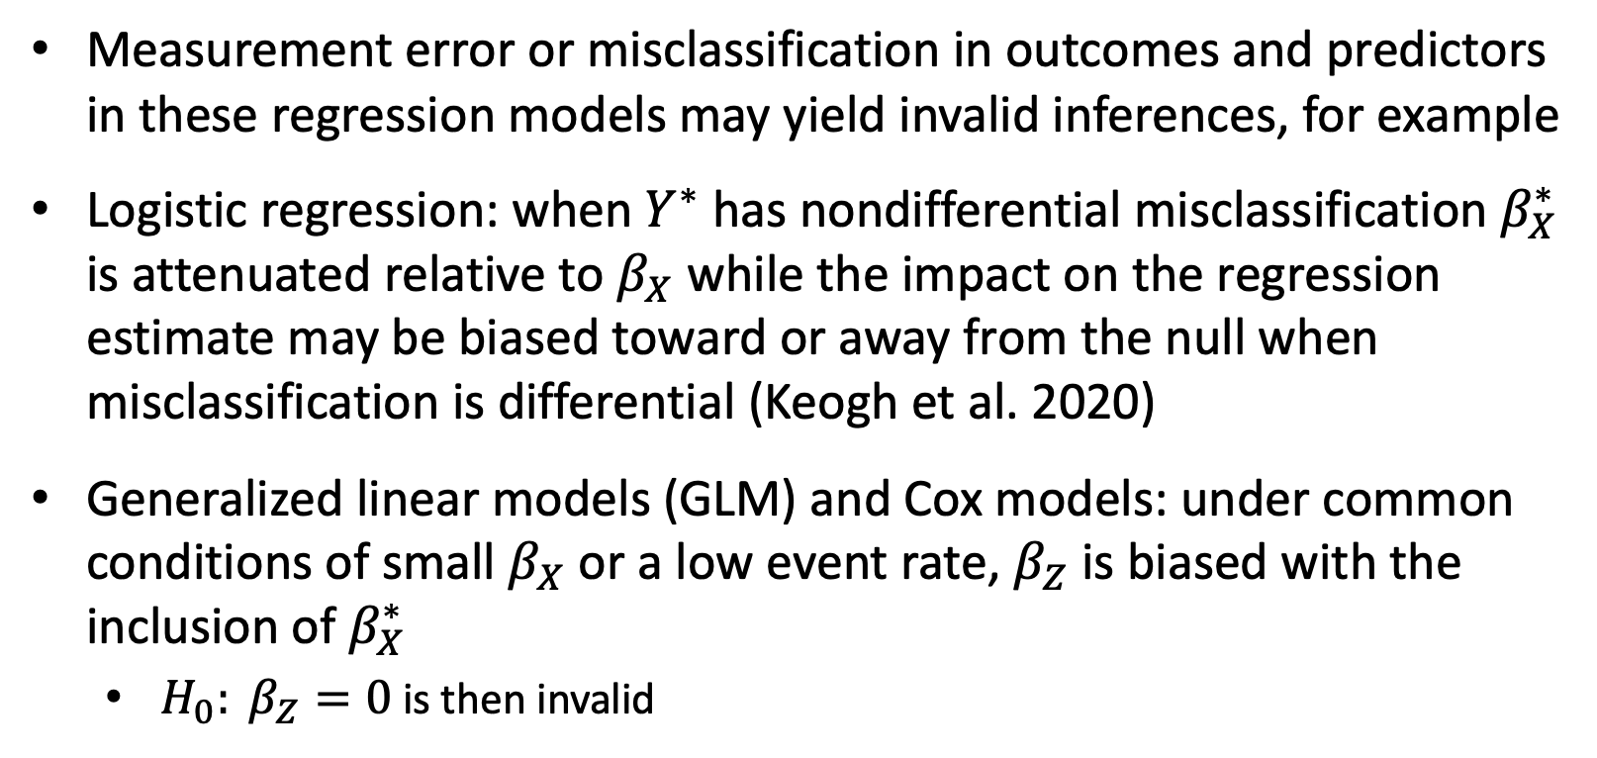
Section 1: Background - Issues that arise in the presence of measurement error
1.2 KS study: measurement error issues
Measurement error or misclassification in outcomes and predictors in these regression models may yield invalid inferences, for example
Logistic regression: when $Y^{∗}$ has nondifferential misclassification $β_{X}^{∗}$ is attenuated relative to $β_{X}$ while the impact on the regression estimate may be biased toward or away from the null when misclassification is differential (Keogh et al. 2020)
Generalized linear models (GLM) and Cox models: under common conditions of small $β_{X}$ or a low event rate, $β_{Z}$ is biased with the inclusion of $β_{X}^{∗}$
${H_{0}: β}_{Z}=0$ is then invalid
Notes:
STRATOS1

Slide 11
Section 2: Statistical methods for measurement error correction Improved estimation and inference.

Slide 12
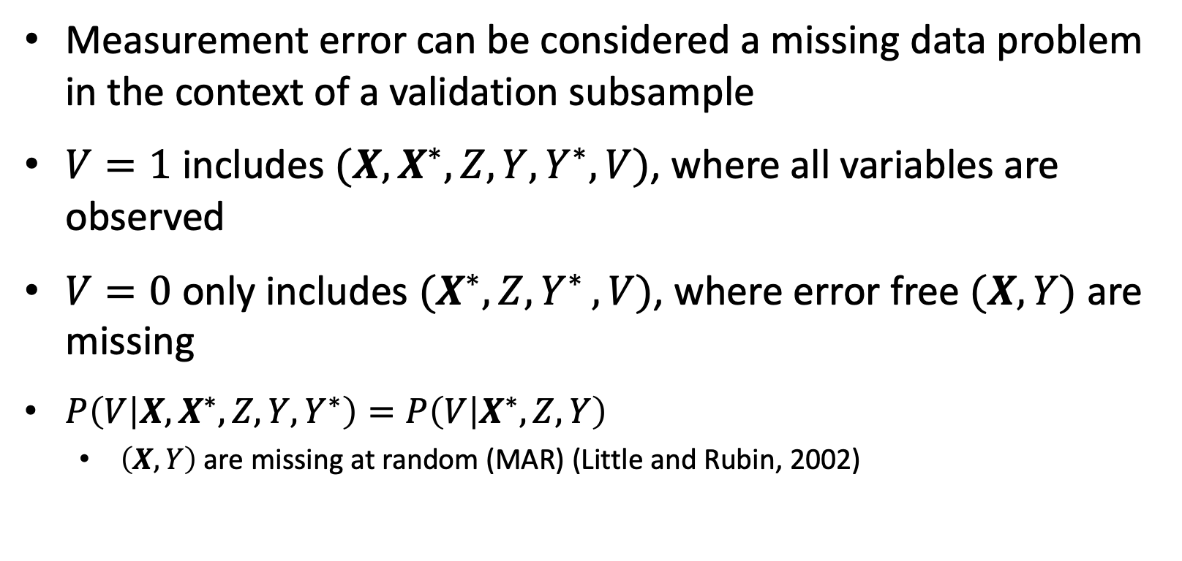
Section 2: Statistical methods for measurement error correction – improved estimation and inference
2.1 Multiple imputation (MI)
Measurement error can be considered a missing data problem in the context of a validation subsample
$V=1$ includes $(X,X^{∗},Z,{Y,Y}^{∗},V)$, where all variables are observed
$V=0$ only includes $(X^{∗},Z{,Y}^{∗},V)$, where error free $(X,Y)$ are missing
$P\left(V | X,X^{∗},Z,{Y,Y}^{∗}\right)=P\left(V | X^{∗},Z,Y\right)$
$\left(X,Y\right)$ are missing at random (MAR) (Little and Rubin, 2002)
Notes:
Little RJ, Rubin DB. Statistical Analysis with Missing Data. 3rd Edition. Wiley, New York, 2019.
Giganti MJ, Shaw PA, Chen G, Bebawy SS, Turner MM, Sterling TR, Shepherd BE. ACCOUNTING FOR DEPENDENT ERRORS IN PREDICTORS AND TIME-TO-EVENT OUTCOMES USING ELECTRONIC HEALTH RECORDS, VALIDATION SAMPLES, AND MULTIPLE IMPUTATION. Ann Appl Stat. 2020 Jun;14(2):1045-1061. doi: 10.1214/20-aoas1343. Epub 2020 Jun 29. PMID: 32999698; PMCID: PMC7523695.
Han K, Shaw PA, Lumley T. Combining multiple imputation with raking of weights: An efficient and robust approach in the setting of nearly true models. Stat Med. 2021 Dec 30;40(30):6777-6791. doi: 10.1002/sim.9210. Epub 2021 Sep 28. PMID: 34585424; PMCID: PMC8963275.

Slide 13
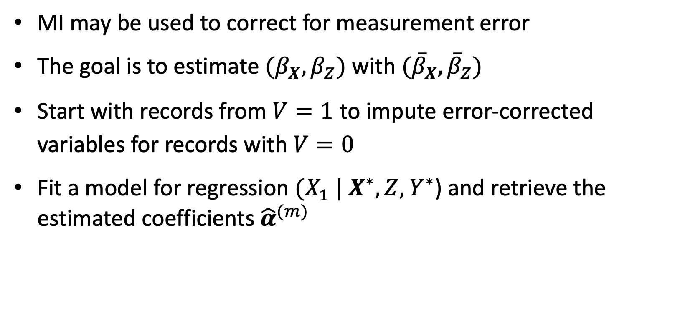
Section 2: Statistical methods for measurement error correction – improved estimation and inference
2.1 Multiple imputation (MI)
MI may be used to correct for measurement error
The goal is to estimate ${(β}_{X},β_{Z})$ with $({\overline{β}}_{X},{\overline{β}}_{Z})$
Start with records from $V=1$ to impute error-corrected variables for records with $V=0$
Fit a model for regression ${(X_{1} | X}^{∗},Z,{ Y}^{∗}$) and retrieve the estimated coefficients ${\hat{α}}^{(m)}$
Notes:
Little RJ, Rubin DB. Statistical Analysis with Missing Data. 3rd Edition. Wiley, New York, 2019.
Giganti MJ, Shaw PA, Chen G, Bebawy SS, Turner MM, Sterling TR, Shepherd BE. ACCOUNTING FOR DEPENDENT ERRORS IN PREDICTORS AND TIME-TO-EVENT OUTCOMES USING ELECTRONIC HEALTH RECORDS, VALIDATION SAMPLES, AND MULTIPLE IMPUTATION. Ann Appl Stat. 2020 Jun;14(2):1045-1061. doi: 10.1214/20-aoas1343. Epub 2020 Jun 29. PMID: 32999698; PMCID: PMC7523695.
Han K, Shaw PA, Lumley T. Combining multiple imputation with raking of weights: An efficient and robust approach in the setting of nearly true models. Stat Med. 2021 Dec 30;40(30):6777-6791. doi: 10.1002/sim.9210. Epub 2021 Sep 28. PMID: 34585424; PMCID: PMC8963275.

Slide 14
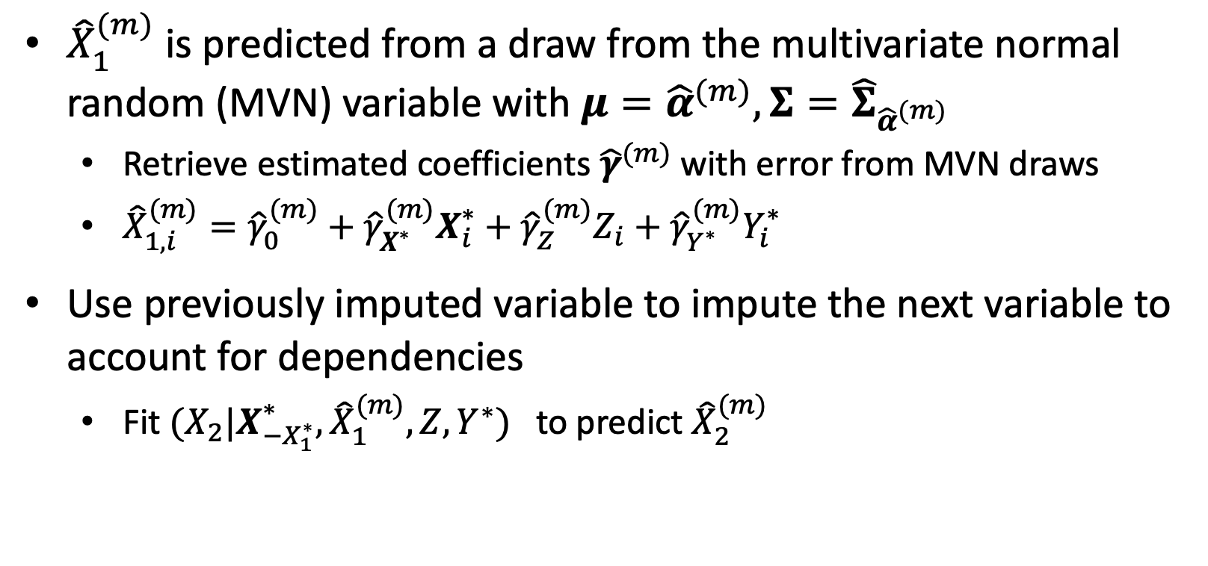
Section 2: Statistical methods for measurement error correction – improved estimation and inference
2.1 Multiple imputation (MI)
${\hat{X}}_{1}^{(m)}$ is predicted from a draw from the multivariate normal random (MVN) variable with $μ={\hat{α}}^{(m)},Σ={\hat{Σ}}_{{\hat{α}}^{(m)}}$
Retrieve estimated coefficients ${\hat{γ}}^{(m)}$ with error from MVN draws
${\hat{X}}_{1,i}^{(m)}={\hat{γ}}_{0}^{(m)}+{\hat{γ}}_{X^{∗}}^{(m)}X_{i}^{∗}+{\hat{γ}}_{Z}^{(m)}Z_{i}$ $+ {\hat{γ}}_{Y^{∗}}^{(m)}Y_{i}^{∗}$
Use previously imputed variable to impute the next variable to account for dependencies
Fit $(X_{2}|X_{{−X}_{1}^{∗}}^{∗},{\hat{X}}_{1}^{(m)},Z,Y^{∗})$ to predict ${\hat{X}}_{2}^{(m)}$
Notes:
Little RJ, Rubin DB. Statistical Analysis with Missing Data. 3rd Edition. Wiley, New York, 2019.
Giganti MJ, Shaw PA, Chen G, Bebawy SS, Turner MM, Sterling TR, Shepherd BE. ACCOUNTING FOR DEPENDENT ERRORS IN PREDICTORS AND TIME-TO-EVENT OUTCOMES USING ELECTRONIC HEALTH RECORDS, VALIDATION SAMPLES, AND MULTIPLE IMPUTATION. Ann Appl Stat. 2020 Jun;14(2):1045-1061. doi: 10.1214/20-aoas1343. Epub 2020 Jun 29. PMID: 32999698; PMCID: PMC7523695.
Han K, Shaw PA, Lumley T. Combining multiple imputation with raking of weights: An efficient and robust approach in the setting of nearly true models. Stat Med. 2021 Dec 30;40(30):6777-6791. doi: 10.1002/sim.9210. Epub 2021 Sep 28. PMID: 34585424; PMCID: PMC8963275.

Slide 15
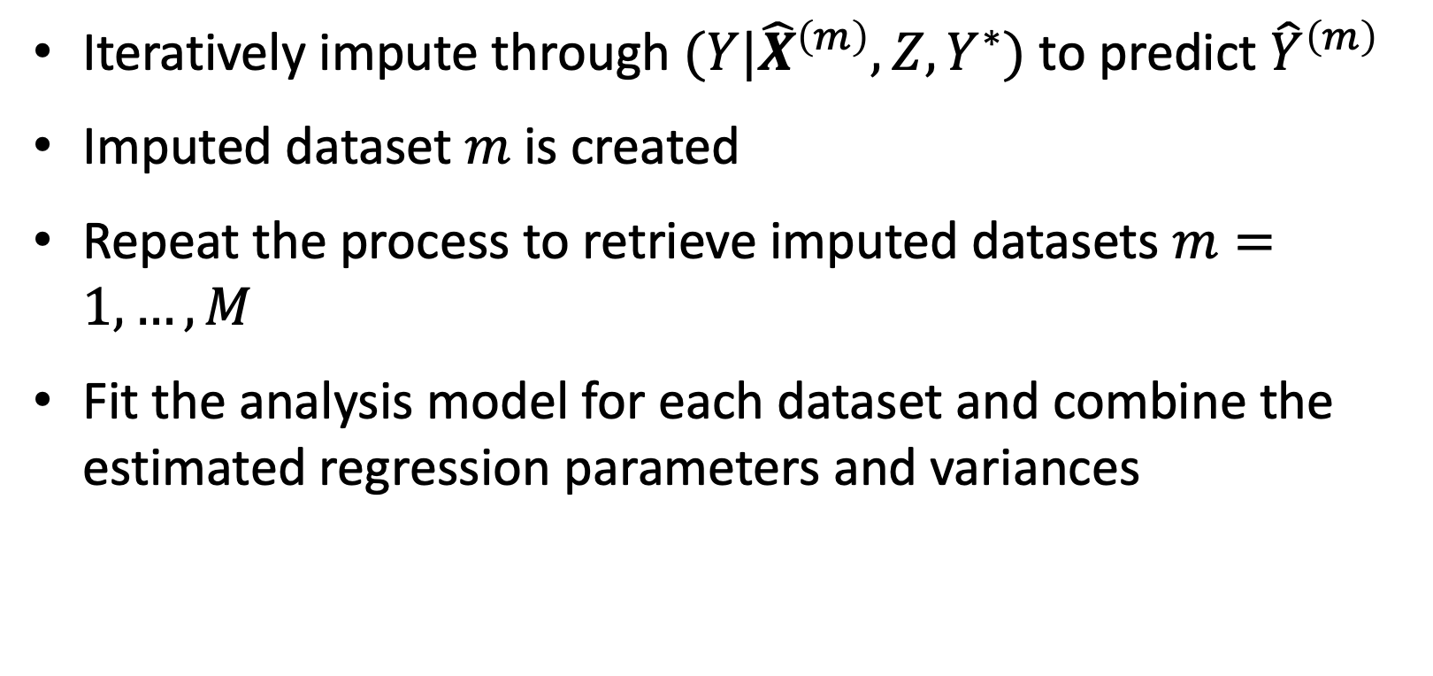
Section 2: Statistical methods for measurement error correction – improved estimation and inference
2.1 Multiple imputation (MI)
Iteratively impute through $(Y|{\hat{X}}^{\left(m\right)},Z,Y^{∗})$ to predict ${\hat{Y}}^{\left(m\right)}$
Imputed dataset $m$ is created
Repeat the process to retrieve imputed datasets $m=1,…,M$
Fit the analysis model for each dataset and combine the estimated regression parameters and variances
Notes:
Little RJ, Rubin DB. Statistical Analysis with Missing Data. 3rd Edition. Wiley, New York, 2019.
Giganti MJ, Shaw PA, Chen G, Bebawy SS, Turner MM, Sterling TR, Shepherd BE. ACCOUNTING FOR DEPENDENT ERRORS IN PREDICTORS AND TIME-TO-EVENT OUTCOMES USING ELECTRONIC HEALTH RECORDS, VALIDATION SAMPLES, AND MULTIPLE IMPUTATION. Ann Appl Stat. 2020 Jun;14(2):1045-1061. doi: 10.1214/20-aoas1343. Epub 2020 Jun 29. PMID: 32999698; PMCID: PMC7523695.
Han K, Shaw PA, Lumley T. Combining multiple imputation with raking of weights: An efficient and robust approach in the setting of nearly true models. Stat Med. 2021 Dec 30;40(30):6777-6791. doi: 10.1002/sim.9210. Epub 2021 Sep 28. PMID: 34585424; PMCID: PMC8963275.

Slide 16
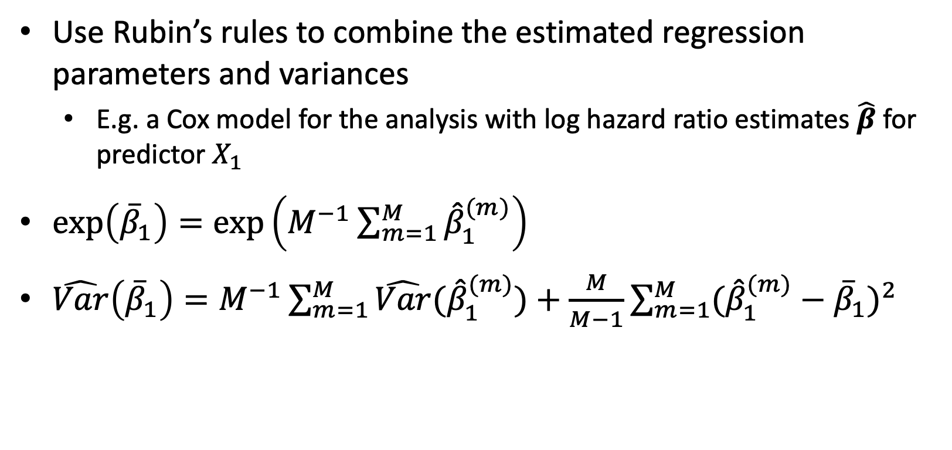
Section 2: Statistical methods for measurement error correction – improved estimation and inference
2.1 Multiple imputation (MI)
Use Rubin’s rules to combine the estimated regression parameters and variances
E.g. a Cox model for the analysis with log hazard ratio estimates $\hat{β}$ for predictor $X_{1}$
$\exp\left({\overline{β}}_{1}\right)=\exp\left(M^{−1}\sum_{m=1}^{M}{{\hat{β}}_{1}^{(m)}}\right)$
$\hat{Var}\left({\overline{β}}_{1}\right)=M^{−1}\sum_{m=1}^{M}{\hat{Var}({\hat{β}}_{1}^{(m)})+\frac{M}{M−1}}\sum_{m=1}^{M}{{(\hat{β}}_{1}^{(m)}}−{\overline{β}}_{1})^{2}$
Notes:
Little RJ, Rubin DB. Statistical Analysis with Missing Data. 3rd Edition. Wiley, New York, 2019.
Giganti MJ, Shaw PA, Chen G, Bebawy SS, Turner MM, Sterling TR, Shepherd BE. ACCOUNTING FOR DEPENDENT ERRORS IN PREDICTORS AND TIME-TO-EVENT OUTCOMES USING ELECTRONIC HEALTH RECORDS, VALIDATION SAMPLES, AND MULTIPLE IMPUTATION. Ann Appl Stat. 2020 Jun;14(2):1045-1061. doi: 10.1214/20-aoas1343. Epub 2020 Jun 29. PMID: 32999698; PMCID: PMC7523695.
Han K, Shaw PA, Lumley T. Combining multiple imputation with raking of weights: An efficient and robust approach in the setting of nearly true models. Stat Med. 2021 Dec 30;40(30):6777-6791. doi: 10.1002/sim.9210. Epub 2021 Sep 28. PMID: 34585424; PMCID: PMC8963275.

Slide 17
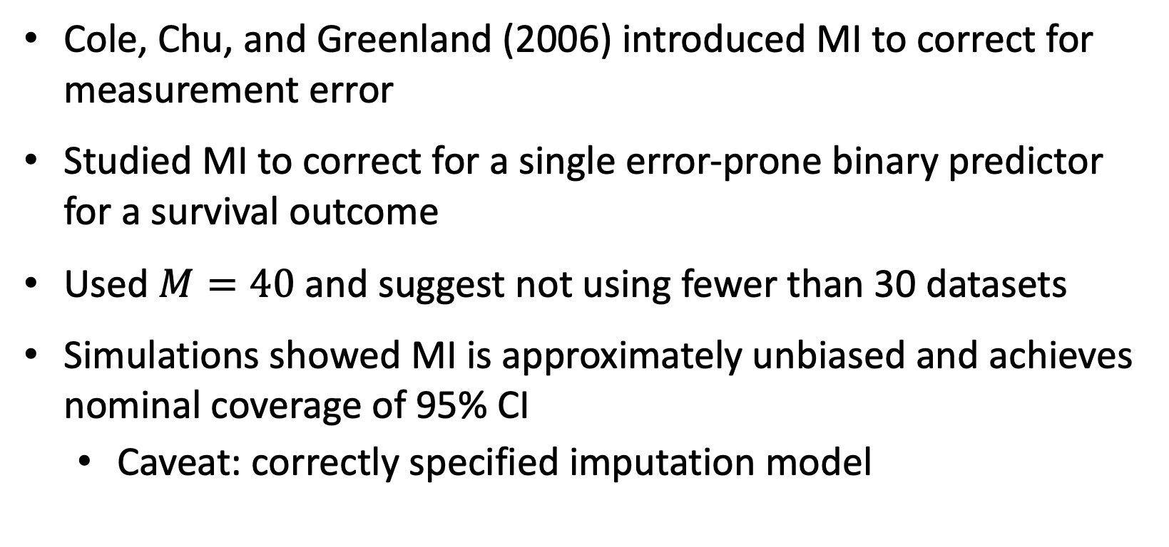
Section 2: Statistical methods for measurement error correction – improved estimation and inference
2.1 Multiple imputation (MI)
Cole, Chu, and Greenland (2006) introduced MI to correct for measurement error
Studied MI to correct for a single error-prone binary predictor for a survival outcome
Used $M=40$ and suggest not using fewer than 30 datasets
Simulations showed MI is approximately unbiased and achieves nominal coverage of 95% CI
Caveat: correctly specified imputation model
Notes:
Little RJ, Rubin DB. Statistical Analysis with Missing Data. 3rd Edition. Wiley, New York, 2019.
Giganti MJ, Shaw PA, Chen G, Bebawy SS, Turner MM, Sterling TR, Shepherd BE. ACCOUNTING FOR DEPENDENT ERRORS IN PREDICTORS AND TIME-TO-EVENT OUTCOMES USING ELECTRONIC HEALTH RECORDS, VALIDATION SAMPLES, AND MULTIPLE IMPUTATION. Ann Appl Stat. 2020 Jun;14(2):1045-1061. doi: 10.1214/20-aoas1343. Epub 2020 Jun 29. PMID: 32999698; PMCID: PMC7523695.
Han K, Shaw PA, Lumley T. Combining multiple imputation with raking of weights: An efficient and robust approach in the setting of nearly true models. Stat Med. 2021 Dec 30;40(30):6777-6791. doi: 10.1002/sim.9210. Epub 2021 Sep 28. PMID: 34585424; PMCID: PMC8963275.

Slide 18
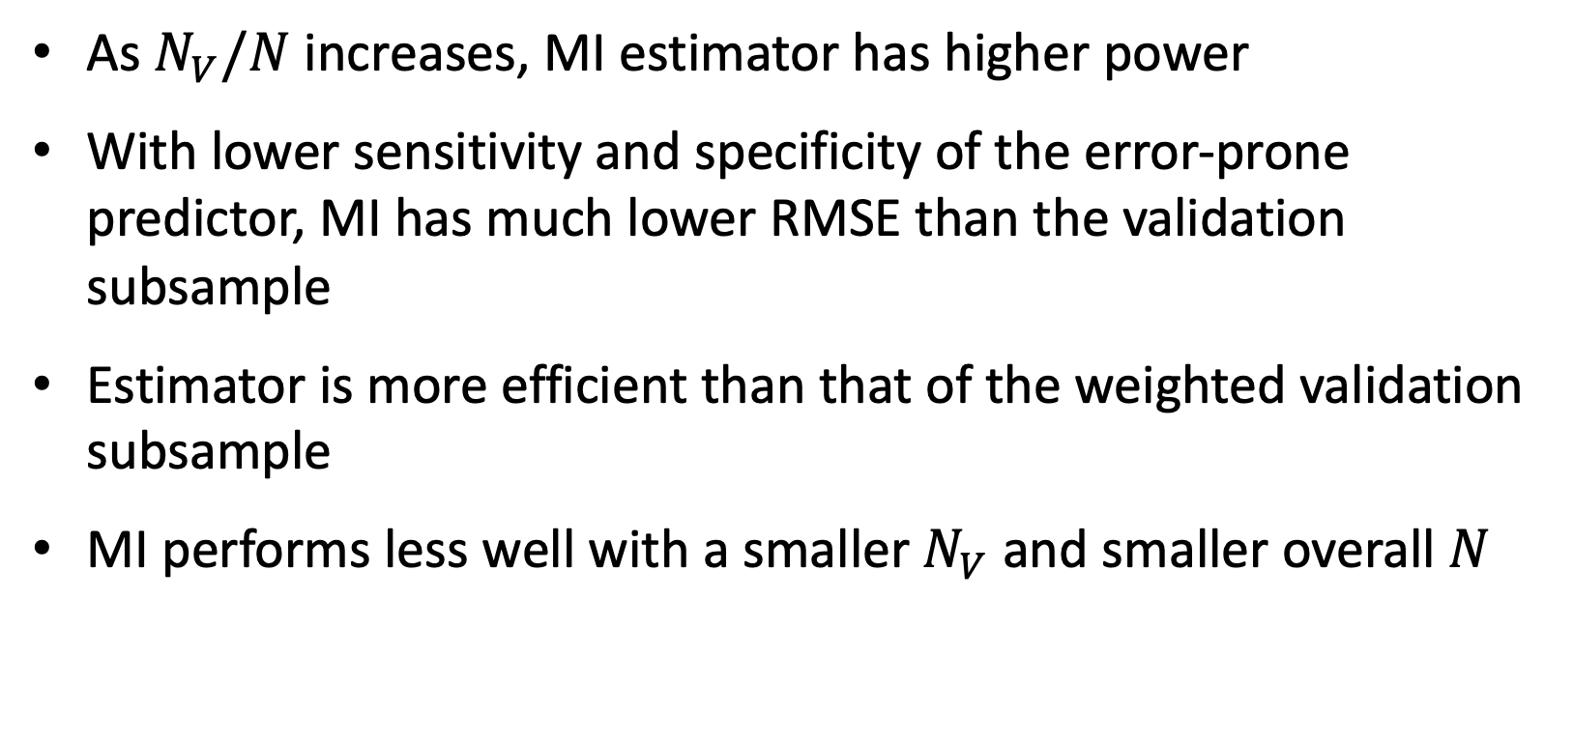
Section 2: Statistical methods for measurement error correction – improved estimation and inference
2.1 Multiple imputation (MI)
As $N_{V}/N$ increases, MI estimator has higher power
With lower sensitivity and specificity of the error-prone predictor, MI has much lower RMSE than the validation subsample
Estimator is more efficient than that of the weighted validation subsample
MI performs less well with a smaller $N_{V}$and smaller overall $N$
Notes:
Little RJ, Rubin DB. Statistical Analysis with Missing Data. 3rd Edition. Wiley, New York, 2019.
Giganti MJ, Shaw PA, Chen G, Bebawy SS, Turner MM, Sterling TR, Shepherd BE. ACCOUNTING FOR DEPENDENT ERRORS IN PREDICTORS AND TIME-TO-EVENT OUTCOMES USING ELECTRONIC HEALTH RECORDS, VALIDATION SAMPLES, AND MULTIPLE IMPUTATION. Ann Appl Stat. 2020 Jun;14(2):1045-1061. doi: 10.1214/20-aoas1343. Epub 2020 Jun 29. PMID: 32999698; PMCID: PMC7523695.
Han K, Shaw PA, Lumley T. Combining multiple imputation with raking of weights: An efficient and robust approach in the setting of nearly true models. Stat Med. 2021 Dec 30;40(30):6777-6791. doi: 10.1002/sim.9210. Epub 2021 Sep 28. PMID: 34585424; PMCID: PMC8963275.

Slide 19
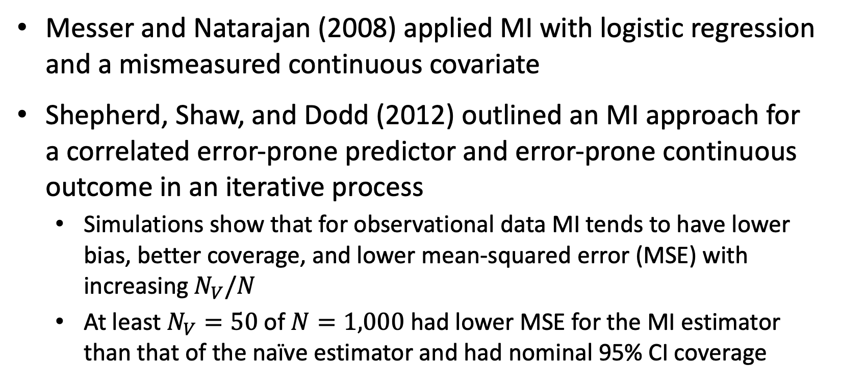
Section 2: Statistical methods for measurement error correction – improved estimation and inference
2.1 Multiple imputation (MI)
Messer and Natarajan (2008) applied MI with logistic regression and a mismeasured continuous covariate
Shepherd, Shaw, and Dodd (2012) outlined an MI approach for a correlated error-prone predictor and error-prone continuous outcome in an iterative process
Simulations show that for observational data MI tends to have lower bias, better coverage, and lower mean-squared error (MSE) with increasing $N_{V}/N$
At least $N_{V}=\text{50}$ of $N=\text{1,00}\text{0}$ had lower MSE for the MI estimator than that of the naïve estimator and had nominal 95% CI coverage
Notes:
Little RJ, Rubin DB. Statistical Analysis with Missing Data. 3rd Edition. Wiley, New York, 2019.
Giganti MJ, Shaw PA, Chen G, Bebawy SS, Turner MM, Sterling TR, Shepherd BE. ACCOUNTING FOR DEPENDENT ERRORS IN PREDICTORS AND TIME-TO-EVENT OUTCOMES USING ELECTRONIC HEALTH RECORDS, VALIDATION SAMPLES, AND MULTIPLE IMPUTATION. Ann Appl Stat. 2020 Jun;14(2):1045-1061. doi: 10.1214/20-aoas1343. Epub 2020 Jun 29. PMID: 32999698; PMCID: PMC7523695.
Han K, Shaw PA, Lumley T. Combining multiple imputation with raking of weights: An efficient and robust approach in the setting of nearly true models. Stat Med. 2021 Dec 30;40(30):6777-6791. doi: 10.1002/sim.9210. Epub 2021 Sep 28. PMID: 34585424; PMCID: PMC8963275.

Slide 20
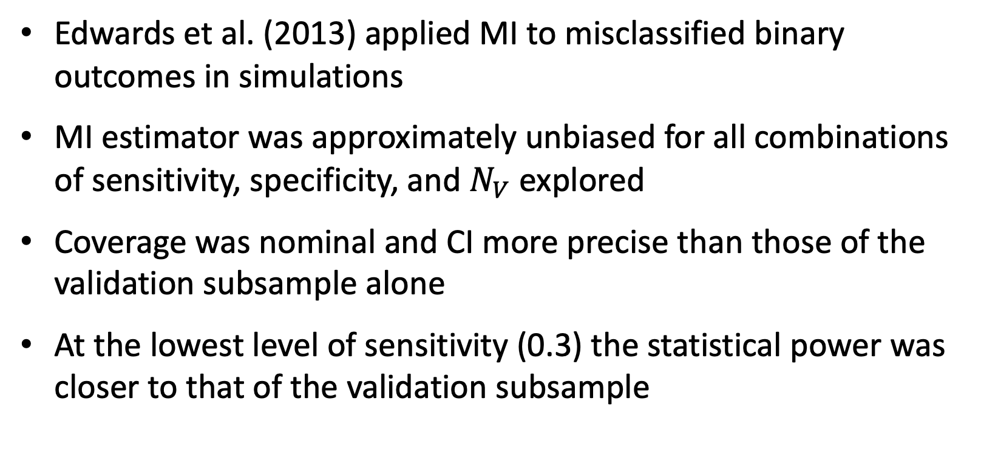
Section 2: Statistical methods for measurement error correction – improved estimation and inference
2.1 Multiple imputation (MI)
Edwards et al. (2013) applied MI to misclassified binary outcomes in simulations
MI estimator was approximately unbiased for all combinations of sensitivity, specificity, and $N_{V}$explored
Coverage was nominal and CI more precise than those of the validation subsample alone
At the lowest level of sensitivity (0.3) the statistical power was closer to that of the validation subsample
Notes:
Little RJ, Rubin DB. Statistical Analysis with Missing Data. 3rd Edition. Wiley, New York, 2019.
Giganti MJ, Shaw PA, Chen G, Bebawy SS, Turner MM, Sterling TR, Shepherd BE. ACCOUNTING FOR DEPENDENT ERRORS IN PREDICTORS AND TIME-TO-EVENT OUTCOMES USING ELECTRONIC HEALTH RECORDS, VALIDATION SAMPLES, AND MULTIPLE IMPUTATION. Ann Appl Stat. 2020 Jun;14(2):1045-1061. doi: 10.1214/20-aoas1343. Epub 2020 Jun 29. PMID: 32999698; PMCID: PMC7523695.
Han K, Shaw PA, Lumley T. Combining multiple imputation with raking of weights: An efficient and robust approach in the setting of nearly true models. Stat Med. 2021 Dec 30;40(30):6777-6791. doi: 10.1002/sim.9210. Epub 2021 Sep 28. PMID: 34585424; PMCID: PMC8963275.

Slide 21
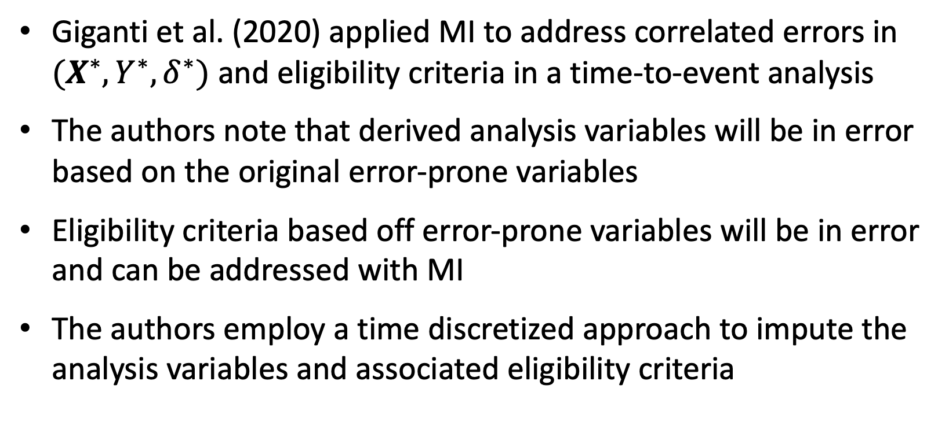
Section 2: Statistical methods for measurement error correction – improved estimation and inference
2.1 Multiple imputation (MI)
Giganti et al. (2020) applied MI to address correlated errors in $(X^{∗},Y^{∗},δ^{∗})$ and eligibility criteria in a time-to-event analysis
The authors note that derived analysis variables will be in error based on the original error-prone variables
Eligibility criteria based off error-prone variables will be in error and can be addressed with MI
The authors employ a time discretized approach to impute the analysis variables and associated eligibility criteria
Notes:
Little RJ, Rubin DB. Statistical Analysis with Missing Data. 3rd Edition. Wiley, New York, 2019.
Giganti MJ, Shaw PA, Chen G, Bebawy SS, Turner MM, Sterling TR, Shepherd BE. ACCOUNTING FOR DEPENDENT ERRORS IN PREDICTORS AND TIME-TO-EVENT OUTCOMES USING ELECTRONIC HEALTH RECORDS, VALIDATION SAMPLES, AND MULTIPLE IMPUTATION. Ann Appl Stat. 2020 Jun;14(2):1045-1061. doi: 10.1214/20-aoas1343. Epub 2020 Jun 29. PMID: 32999698; PMCID: PMC7523695.
Han K, Shaw PA, Lumley T. Combining multiple imputation with raking of weights: An efficient and robust approach in the setting of nearly true models. Stat Med. 2021 Dec 30;40(30):6777-6791. doi: 10.1002/sim.9210. Epub 2021 Sep 28. PMID: 34585424; PMCID: PMC8963275.

Slide 22
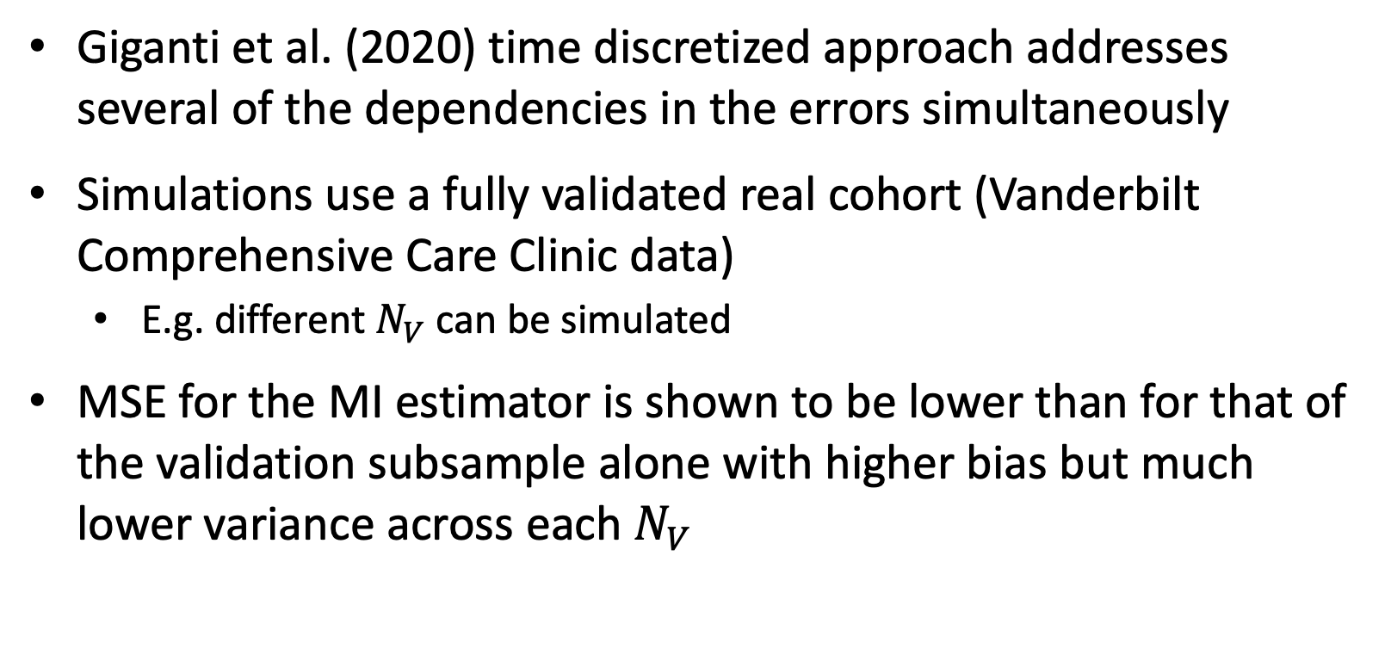
Section 2: Statistical methods for measurement error correction – improved estimation and inference
2.1 Multiple imputation (MI)
Giganti et al. (2020) time discretized approach addresses several of the dependencies in the errors simultaneously
Simulations use a fully validated real cohort (Vanderbilt Comprehensive Care Clinic data)
E.g. different $N_{V}$ can be simulated
MSE for the MI estimator is shown to be lower than for that of the validation subsample alone with higher bias but much lower variance across each $N_{V}$
Notes:
Little RJ, Rubin DB. Statistical Analysis with Missing Data. 3rd Edition. Wiley, New York, 2019.
Giganti MJ, Shaw PA, Chen G, Bebawy SS, Turner MM, Sterling TR, Shepherd BE. ACCOUNTING FOR DEPENDENT ERRORS IN PREDICTORS AND TIME-TO-EVENT OUTCOMES USING ELECTRONIC HEALTH RECORDS, VALIDATION SAMPLES, AND MULTIPLE IMPUTATION. Ann Appl Stat. 2020 Jun;14(2):1045-1061. doi: 10.1214/20-aoas1343. Epub 2020 Jun 29. PMID: 32999698; PMCID: PMC7523695.
Han K, Shaw PA, Lumley T. Combining multiple imputation with raking of weights: An efficient and robust approach in the setting of nearly true models. Stat Med. 2021 Dec 30;40(30):6777-6791. doi: 10.1002/sim.9210. Epub 2021 Sep 28. PMID: 34585424; PMCID: PMC8963275.

Slide 23
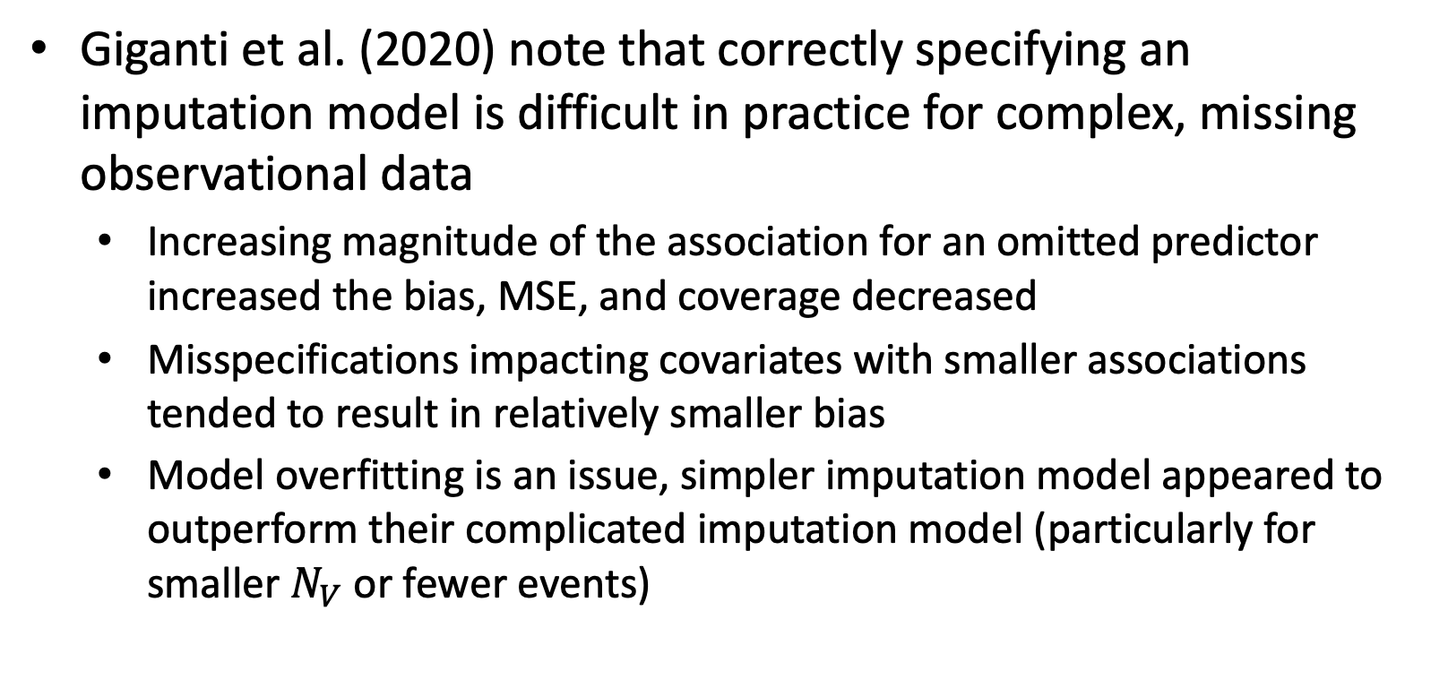
Section 2: Statistical methods for measurement error correction – improved estimation and inference
2.1 Multiple imputation (MI)
Giganti et al. (2020) note that correctly specifying an imputation model is difficult in practice for complex, missing observational data
Increasing magnitude of the association for an omitted predictor increased the bias, MSE, and coverage decreased
Misspecifications impacting covariates with smaller associations tended to result in relatively smaller bias
Model overfitting is an issue, simpler imputation model appeared to outperform their complicated imputation model (particularly for smaller $N_{V}$ or fewer events)
Notes:
Little RJ, Rubin DB. Statistical Analysis with Missing Data. 3rd Edition. Wiley, New York, 2019.
Giganti MJ, Shaw PA, Chen G, Bebawy SS, Turner MM, Sterling TR, Shepherd BE. ACCOUNTING FOR DEPENDENT ERRORS IN PREDICTORS AND TIME-TO-EVENT OUTCOMES USING ELECTRONIC HEALTH RECORDS, VALIDATION SAMPLES, AND MULTIPLE IMPUTATION. Ann Appl Stat. 2020 Jun;14(2):1045-1061. doi: 10.1214/20-aoas1343. Epub 2020 Jun 29. PMID: 32999698; PMCID: PMC7523695.
Han K, Shaw PA, Lumley T. Combining multiple imputation with raking of weights: An efficient and robust approach in the setting of nearly true models. Stat Med. 2021 Dec 30;40(30):6777-6791. doi: 10.1002/sim.9210. Epub 2021 Sep 28. PMID: 34585424; PMCID: PMC8963275.

Slide 24
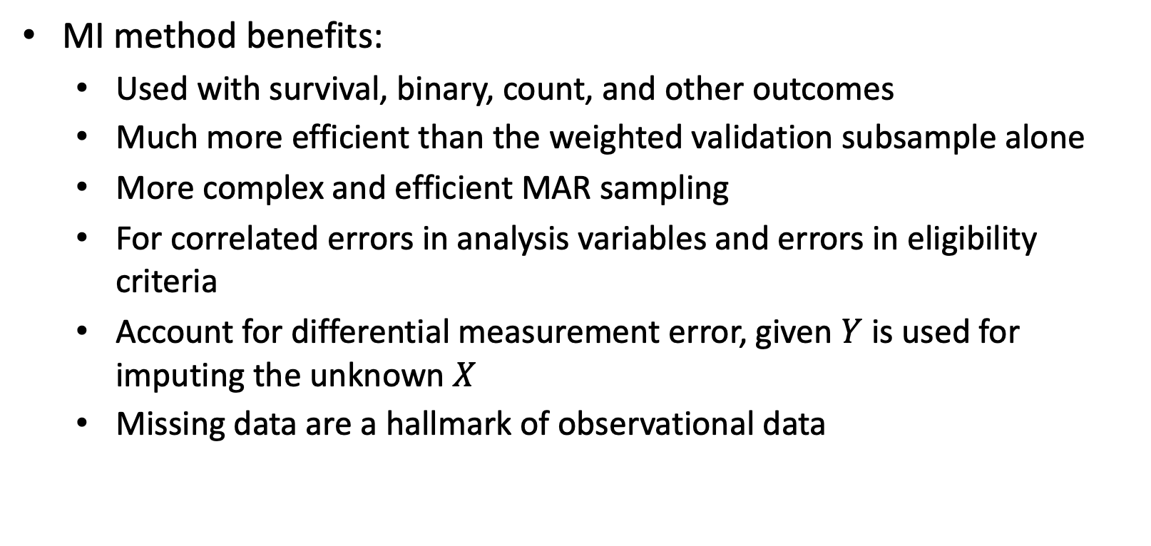
Section 2: Statistical methods for measurement error correction – improved estimation and inference
2.1 Multiple imputation (MI)
MI method benefits:
Used with survival, binary, count, and other outcomes
Much more efficient than the weighted validation subsample alone
More complex and efficient MAR sampling
For correlated errors in analysis variables and errors in eligibility criteria
Account for differential measurement error, given $Y$ is used for imputing the unknown $X$
Missing data are a hallmark of observational data
Notes:
Little RJ, Rubin DB. Statistical Analysis with Missing Data. 3rd Edition. Wiley, New York, 2019.
Giganti MJ, Shaw PA, Chen G, Bebawy SS, Turner MM, Sterling TR, Shepherd BE. ACCOUNTING FOR DEPENDENT ERRORS IN PREDICTORS AND TIME-TO-EVENT OUTCOMES USING ELECTRONIC HEALTH RECORDS, VALIDATION SAMPLES, AND MULTIPLE IMPUTATION. Ann Appl Stat. 2020 Jun;14(2):1045-1061. doi: 10.1214/20-aoas1343. Epub 2020 Jun 29. PMID: 32999698; PMCID: PMC7523695.
Han K, Shaw PA, Lumley T. Combining multiple imputation with raking of weights: An efficient and robust approach in the setting of nearly true models. Stat Med. 2021 Dec 30;40(30):6777-6791. doi: 10.1002/sim.9210. Epub 2021 Sep 28. PMID: 34585424; PMCID: PMC8963275.

Slide 25
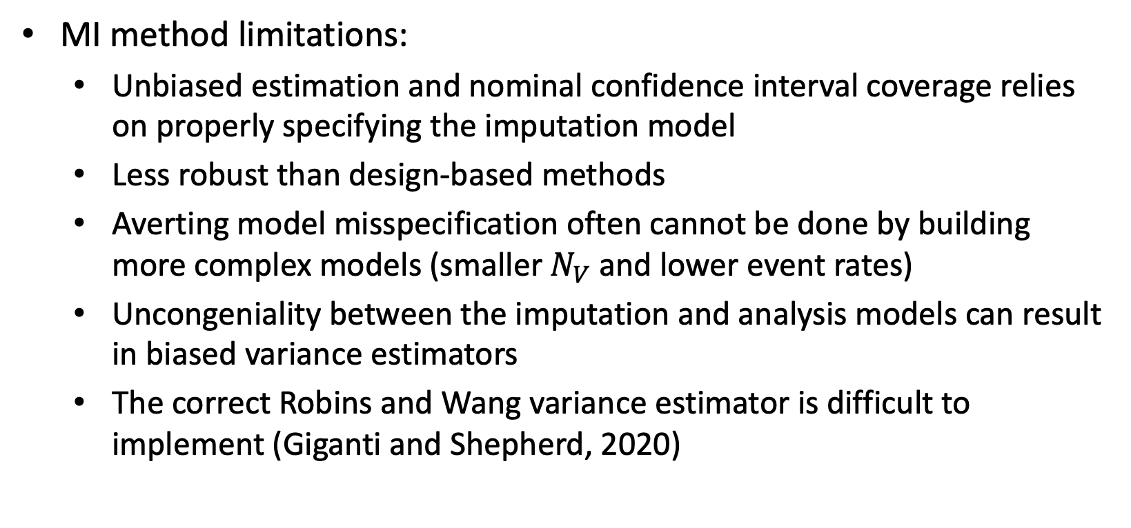
Section 2: Statistical methods for measurement error correction – improved estimation and inference
2.1 Multiple imputation (MI)
MI method limitations:
Unbiased estimation and nominal confidence interval coverage relies on properly specifying the imputation model
Less robust than design-based methods
Averting model misspecification often cannot be done by building more complex models (smaller $N_{V}$ and lower event rates)
Uncongeniality between the imputation and analysis models can result in biased variance estimators
The correct Robins and Wang variance estimator is difficult to implement (Giganti and Shepherd, 2020)
Notes:
Little RJ, Rubin DB. Statistical Analysis with Missing Data. 3rd Edition. Wiley, New York, 2019.
Giganti MJ, Shaw PA, Chen G, Bebawy SS, Turner MM, Sterling TR, Shepherd BE. ACCOUNTING FOR DEPENDENT ERRORS IN PREDICTORS AND TIME-TO-EVENT OUTCOMES USING ELECTRONIC HEALTH RECORDS, VALIDATION SAMPLES, AND MULTIPLE IMPUTATION. Ann Appl Stat. 2020 Jun;14(2):1045-1061. doi: 10.1214/20-aoas1343. Epub 2020 Jun 29. PMID: 32999698; PMCID: PMC7523695.
Han K, Shaw PA, Lumley T. Combining multiple imputation with raking of weights: An efficient and robust approach in the setting of nearly true models. Stat Med. 2021 Dec 30;40(30):6777-6791. doi: 10.1002/sim.9210. Epub 2021 Sep 28. PMID: 34585424; PMCID: PMC8963275.

Slide 26
Section 2: Statistical methods for measurement error correction – improved estimation and inference
2.2 Inverse probability weighting (IPW)
IPW is a common design-based estimator to utilize the validation data
Traditional method to account for complex sampling schemes
Horvitz and Thompson (1952) proposed the general form of population total estimator for a survey sample and its standard error estimate
Estimates for other population quantities are functions of population totals, so the Horvitz-Thompson or IPW estimator is the basis for design-based approaches
Notes:
Lumley, T. (2010) Complex surveys. Hoboken: John Wiley & Sons, Inc.
Deville JC, Särndal CE. Calibration estimators in survey sampling. J Am Stat Assoc. 1992;87(418):376–382.

Slide 27
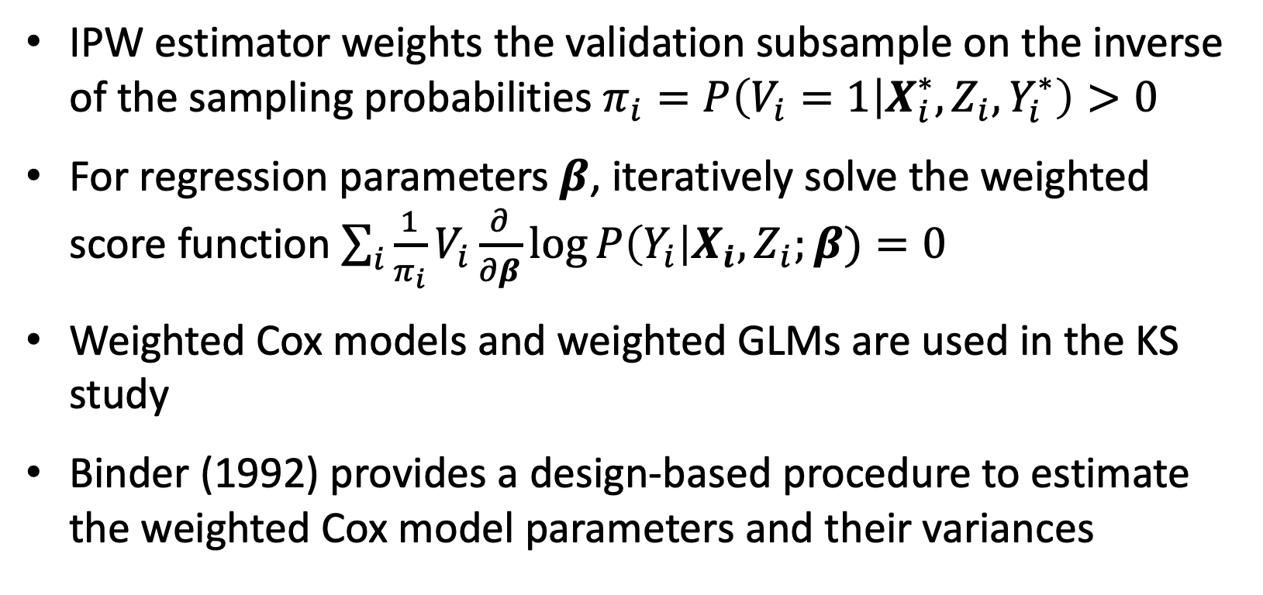
Section 2: Statistical methods for measurement error correction – improved estimation and inference
2.2 Inverse probability weighting (IPW)
IPW estimator weights the validation subsample on the inverse of the sampling probabilities $π_{i}=P\left(V_{i}=1 | X_{i}^{∗},Z_{i},Y_{i}^{∗}\right)>0$
For regression parameters $β$, iteratively solve the weighted score function $\sum_{i}{\frac{1}{π_{i}}V_{i}\frac{∂}{∂β}log⁡P\left(Y_{i}\right|X_{i}, Z_{i};β)}=0$
Weighted Cox models and weighted GLMs are used in the KS study
Binder (1992) provides a design-based procedure to estimate the weighted Cox model parameters and their variances
Notes:
Lumley, T. (2010) Complex surveys. Hoboken: John Wiley & Sons, Inc.
Deville JC, Särndal CE. Calibration estimators in survey sampling. J Am Stat Assoc. 1992;87(418):376–382.

Slide 28
Section 2: Statistical methods for measurement error correction – improved estimation and inference
2.2 Inverse probability weighting (IPW)
Binder illustrates that the variance estimator of the weighted Cox model is unbiased via derivation and simulations
Binder (1983) proposes a consistent variance estimator for weighted logistic regression where weights come from a survey
Binder’s methods are used in the survey package in R for svycoxph() and svyglm()
Notes:
Lumley, T. (2010) Complex surveys. Hoboken: John Wiley & Sons, Inc.
Deville JC, Särndal CE. Calibration estimators in survey sampling. J Am Stat Assoc. 1992;87(418):376–382.

Slide 29
Section 2: Statistical methods for measurement error correction – improved estimation and inference
2.2 Inverse probability weighting (IPW)
Design-based estimators allow for stratified validation subsampling schemes
Over-sampling of cases such as a case-cohort design
Designs with known positive probability of selection
Optimal designs are designs that minimize the variance of the estimator of interest
Neyman (1934) allocation is the optimal (minimizes total population variance) sampling scheme for mutually exclusive strata and fixed total sample size
Notes:
Lumley, T. (2010) Complex surveys. Hoboken: John Wiley & Sons, Inc.
Deville JC, Särndal CE. Calibration estimators in survey sampling. J Am Stat Assoc. 1992;87(418):376–382.

Slide 30
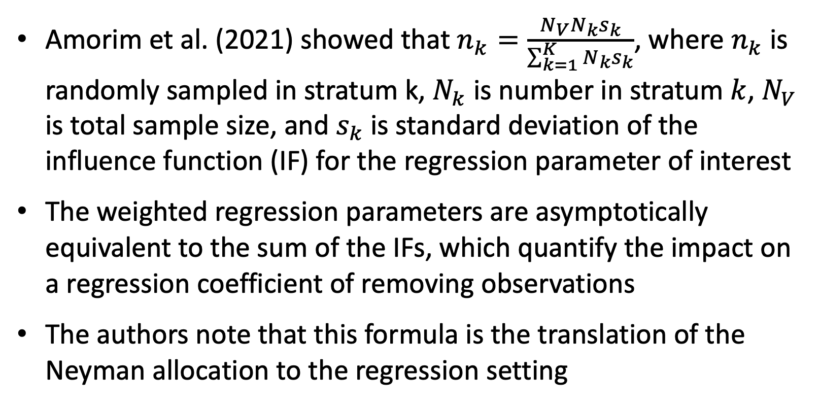
Section 2: Statistical methods for measurement error correction – improved estimation and inference
2.2 Inverse probability weighting (IPW)
Amorim et al. (2021) showed that $n_{k}=\frac{N_{V}N_{k}s_{k}}{\sum_{k=1}^{K}{N_{k}s_{k}}}$, where $n_{k}$ is randomly sampled in stratum k, $N_{k}$ is number in stratum $k$, $N_{V}$ is total sample size, and $s_{k}$is standard deviation of the influence function (IF) for the regression parameter of interest
The weighted regression parameters are asymptotically equivalent to the sum of the IFs, which quantify the impact on a regression coefficient of removing observations
The authors note that this formula is the translation of the Neyman allocation to the regression setting
Notes:
Lumley, T. (2010) Complex surveys. Hoboken: John Wiley & Sons, Inc.
Deville JC, Särndal CE. Calibration estimators in survey sampling. J Am Stat Assoc. 1992;87(418):376–382.

Slide 31
Section 2: Statistical methods for measurement error correction – improved estimation and inference
2.2 Inverse probability weighting (IPW)
IPW estimator is unbiased and robust with minimal assumptions but inefficient
MAR validation subsample
Excludes the full error-prone dataset from the analysis
Robin’s et al. (1994) show that the Horvitz-Thompson estimation is inefficient in the class of augmented inverse probability weighted (AIPW) estimators
Notes:
Lumley, T. (2010) Complex surveys. Hoboken: John Wiley & Sons, Inc.
Deville JC, Särndal CE. Calibration estimators in survey sampling. J Am Stat Assoc. 1992;87(418):376–382.

Slide 32
Section 2: Statistical methods for measurement error correction – improved estimation and inference
2.2 Inverse probability weighting (IPW)
Goals in correcting for measurement error:
Use an estimator that requires minimal assumptions for unbiasedness
Makes use of the entire error-prone cohort data
Accordingly, is more efficient than IPW
Notes:
Lumley, T. (2010) Complex surveys. Hoboken: John Wiley & Sons, Inc.
Deville JC, Särndal CE. Calibration estimators in survey sampling. J Am Stat Assoc. 1992;87(418):376–382.

Slide 33
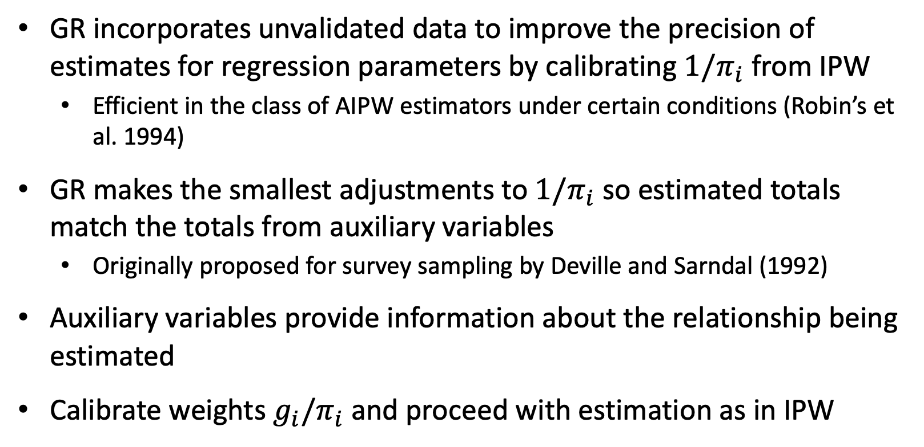
Section 2: Statistical methods for measurement error correction – improved estimation and inference
2.3 Generalized raking (GR)
GR incorporates unvalidated data to improve the precision of estimates for regression parameters by calibrating ${1/π}_{i}$ from IPW
Efficient in the class of AIPW estimators under certain conditions (Robin’s et al. 1994)
GR makes the smallest adjustments to ${1/π}_{i}$ so estimated totals match the totals from auxiliary variables
Originally proposed for survey sampling by Deville and Sarndal (1992)
Auxiliary variables provide information about the relationship being estimated
Calibrate weights $g_{i}/π_{i}$ and proceed with estimation as in IPW
Notes:
Lumley, T. (2010) Complex surveys. Hoboken: John Wiley & Sons, Inc.
Deville JC, Särndal CE. Calibration estimators in survey sampling. J Am Stat Assoc. 1992;87(418):376–382.

Slide 34
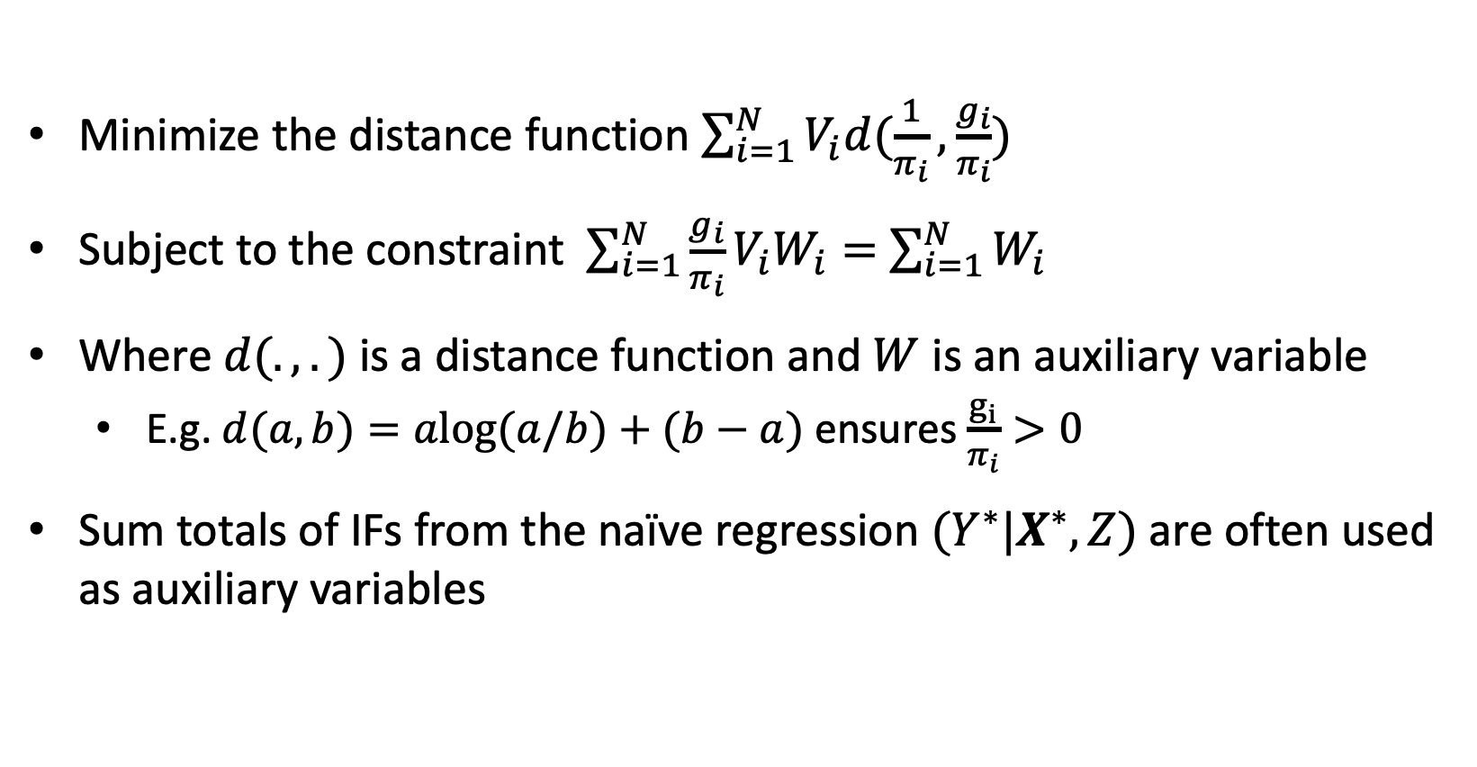
Section 2: Statistical methods for measurement error correction – improved estimation and inference
2.3 Generalized raking (GR)
Minimize the distance function $\sum_{i=1}^{N}{V_{i}d(\frac{1}{π_{i}},\frac{g_{i}}{π_{i}})}$
Subject to the constraint $\sum_{i=1}^{N}{\frac{g_{i}}{π_{i}}{V_{i}W}_{i}}=$ $\sum_{i=1}^{N}{W_{i}}$
Where $d(.,.)$ is a distance function and $W$ is an auxiliary variable
E.g. $d(a,b)=alog⁡(a/b)+(b−a)$ ensures $\frac{g_{i}}{π_{i}}>0$
Sum totals of IFs from the naïve regression $(Y^{∗}|X^{∗},Z)$ are often used as auxiliary variables
Notes:
Lumley, T. (2010) Complex surveys. Hoboken: John Wiley & Sons, Inc.
Deville JC, Särndal CE. Calibration estimators in survey sampling. J Am Stat Assoc. 1992;87(418):376–382.

Slide 35
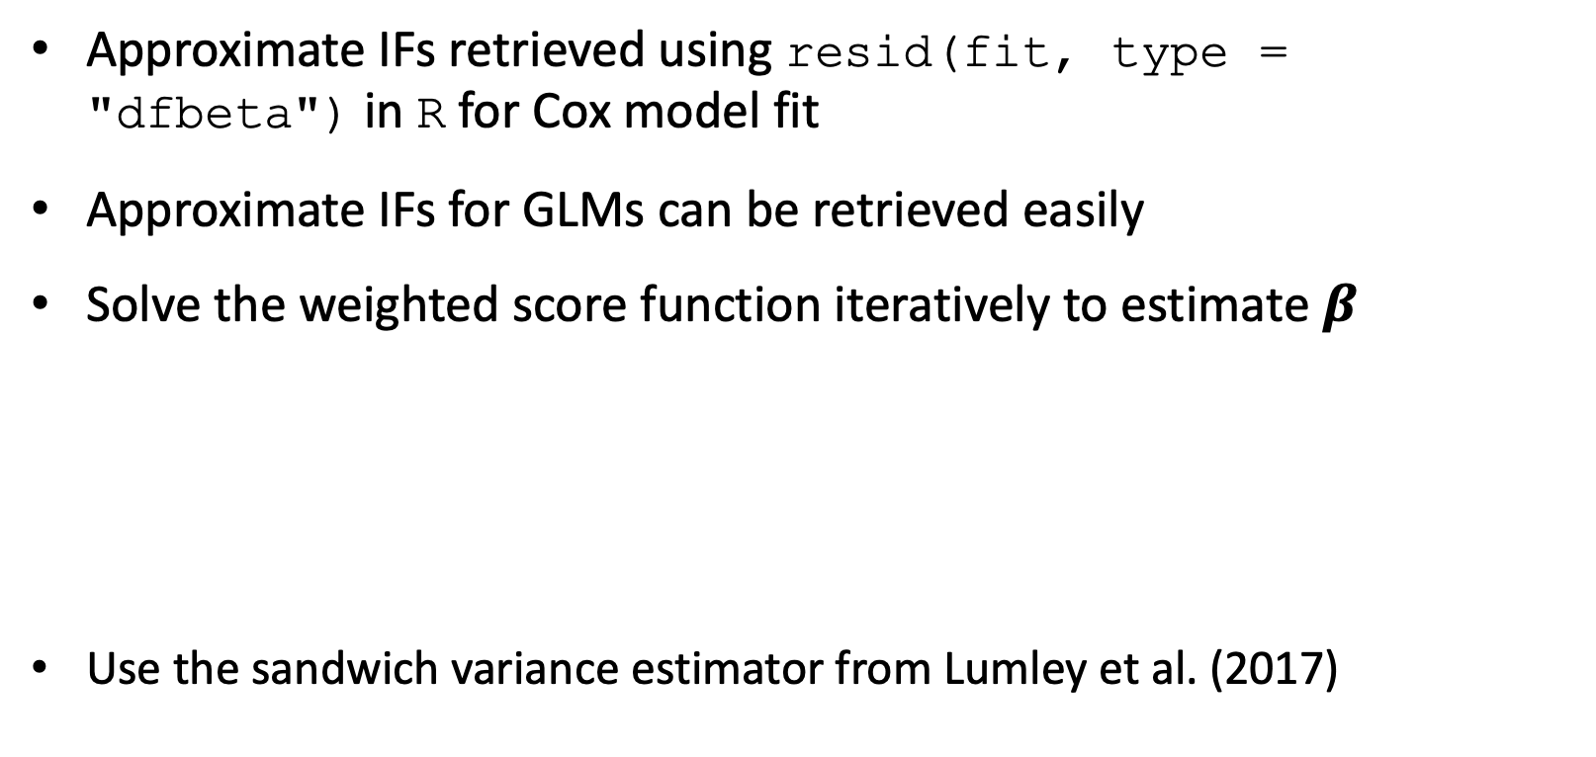
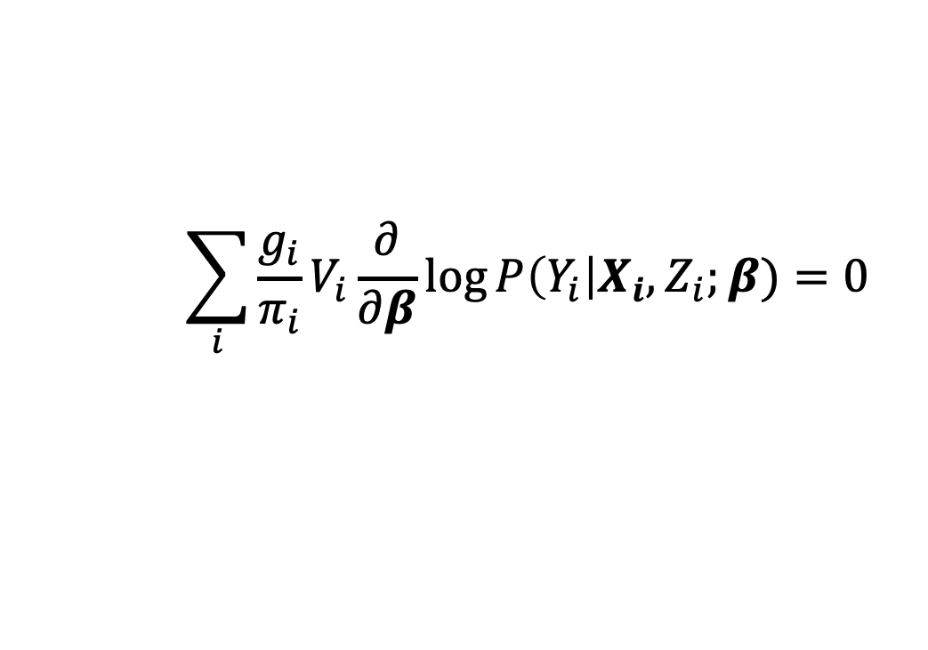
Section 2: Statistical methods for measurement error correction – improved estimation and inference
2.3 Generalized raking (GR)
Approximate IFs retrieved using resid(fit, type = "dfbeta") in R for Cox model fit
Approximate IFs for GLMs can be retrieved easily
Solve the weighted score function iteratively to estimate $β$
Use the sandwich variance estimator from Lumley et al. (2017)
$$\sum_{i}{\frac{g_{i}}{π_{i}}V_{i}\frac{∂}{∂β}log⁡P\left(Y_{i}\right|X_{i}, Z_{i};β)}=0$$
Notes:
Breslow NE, Lumley T, Ballantyne CM, Chambless LE, Kulich M. Using the whole cohort in the analysis of case-cohort data. Am J Epidemiol. 2009 Jun 1;169(11):1398-405. doi: 10.1093/aje/kwp055. Epub 2009 Apr 8. PMID: 19357328; PMCID: PMC2768499.
Lumley, T. (2010). Complex Surveys: A Guide to Analysis Using R. John Wiley and Sons.
Therneau TM, Grambsch PM (2000) Modeling survival data: extending the Cox model. Springer, New York page. 155
Amorim G, Tao R, Lotspeich S, Shaw PA, Lumley T, Shepherd BE. Two-Phase Sampling Designs for Data Validation in Settings with Covariate Measurement Error and Continuous Outcome. J R Stat Soc Ser A Stat Soc. 2021 Oct;184(4):1368-1389. doi: 10.1111/rssa.12689. Epub 2021 Apr 15. PMID: 34975235; PMCID: PMC8715909.
Shepherd BE, Han K, Chen T, Bian A, Pugh S, Duda SN, Lumley T, Heerman WJ, Shaw PA. Multiwave validation sampling for error-prone electronic health records. Biometrics. 2023 Sep;79(3):2649-2663. doi: 10.1111/biom.13713. Epub 2022 Jul 11. PMID: 35775996; PMCID: PMC10525037.

Slide 36
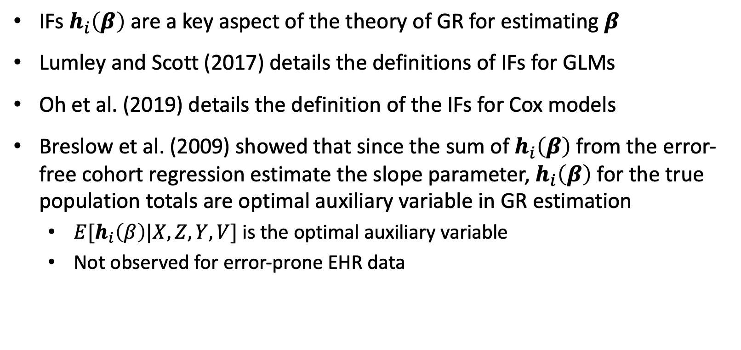
Section 2: Statistical methods for measurement error correction – improved estimation and inference
2.3 Generalized raking (GR)
IFs $h_{i}\left(β\right)$are a key aspect of the theory of GR for estimating $β$
Lumley and Scott (2017) details the definitions of IFs for GLMs
Oh et al. (2019) details the definition of the IFs for Cox models
Breslow et al. (2009) showed that since the sum of $h_{i}\left(β\right)$from the error-free cohort regression estimate the slope parameter, $h_{i}\left(β\right)$ for the true population totals are optimal auxiliary variable in GR estimation
$E[h_{i}\left(β\right)|X,Z,Y,V]$ is the optimal auxiliary variable
Not observed for error-prone EHR data
Notes:
Lumley, T. (2010) Complex surveys. Hoboken: John Wiley & Sons, Inc.
Deville JC, Särndal CE. Calibration estimators in survey sampling. J Am Stat Assoc. 1992;87(418):376–382.

Slide 37
Section 2: Statistical methods for measurement error correction – improved estimation and inference
2.3 Generalized raking (GR)
Breslow et al. (2009), Lumley (2010), and Oh et al. (2019) have used the error-prone full cohort IFs as auxiliary variables for GR
Breslow et al. (2009) showed via simulations from repeated sampling of the National Wilms Tumor Study that the GR estimator is approximately unbiased and more efficient than IPW
The efficiency of the GR estimator depends on the correlation between the auxiliary raking variables and the parameter of estimation
Error-prone IFs can be highly correlated with the true influence functions under low to moderate levels of measurement error
Notes:
Lumley, T. (2010) Complex surveys. Hoboken: John Wiley & Sons, Inc.
Deville JC, Särndal CE. Calibration estimators in survey sampling. J Am Stat Assoc. 1992;87(418):376–382.

Slide 38
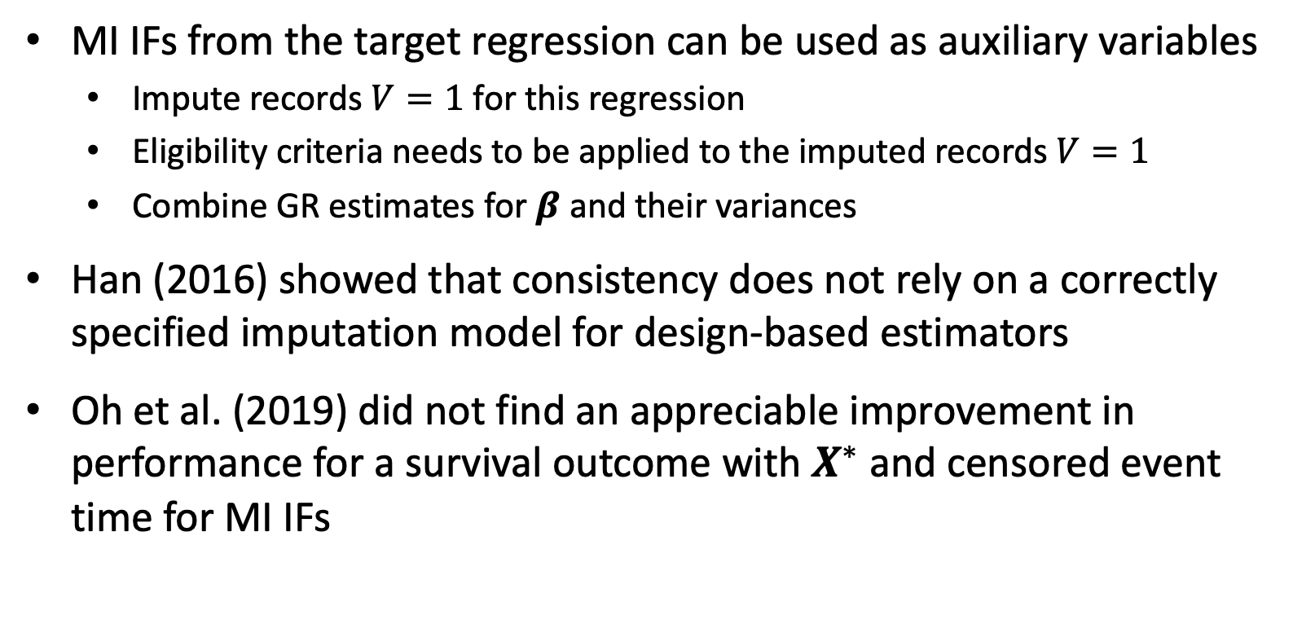
Section 2: Statistical methods for measurement error correction – improved estimation and inference
2.3 Generalized raking (GR)
MI IFs from the target regression can be used as auxiliary variables
Impute records $V=1$ for this regression
Eligibility criteria needs to be applied to the imputed records $V=1$
Combine GR estimates for $β$ and their variances
Han (2016) showed that consistency does not rely on a correctly specified imputation model for design-based estimators
Oh et al. (2019) did not find an appreciable improvement in performance for a survival outcome with $X^{∗}$ and censored event time for MI IFs
Notes:
Lumley, T. (2010) Complex surveys. Hoboken: John Wiley & Sons, Inc.
Deville JC, Särndal CE. Calibration estimators in survey sampling. J Am Stat Assoc. 1992;87(418):376–382.

Slide 39
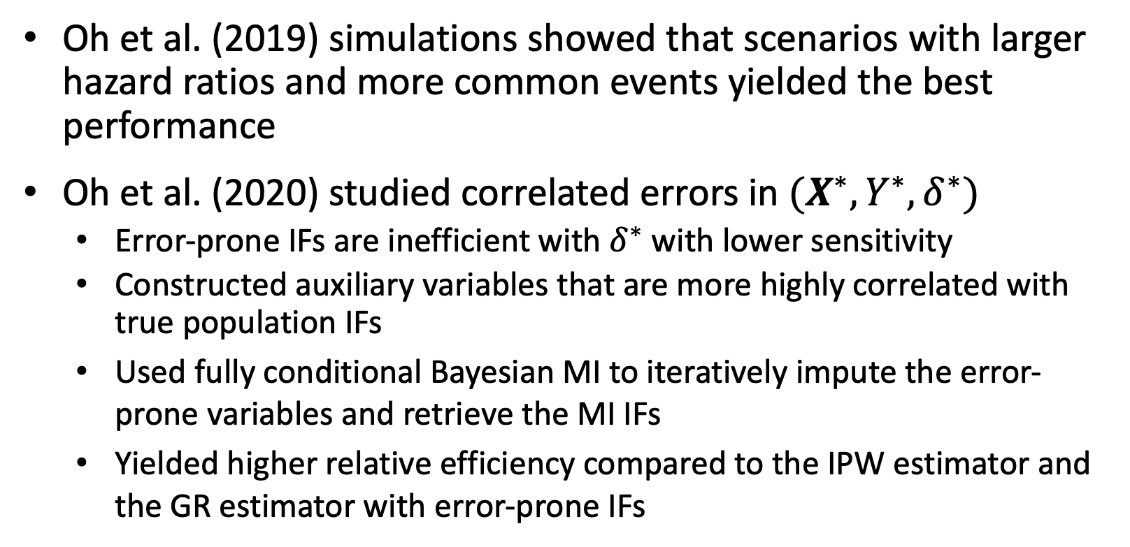
Section 2: Statistical methods for measurement error correction – improved estimation and inference
2.3 Generalized raking (GR)
Oh et al. (2019) simulations showed that scenarios with larger hazard ratios and more common events yielded the best performance
Oh et al. (2020) studied correlated errors in $(X^{∗},Y^{∗},δ^{∗})$
Error-prone IFs are inefficient with $δ^{∗}$ with lower sensitivity
Constructed auxiliary variables that are more highly correlated with true population IFs
Used fully conditional Bayesian MI to iteratively impute the error-prone variables and retrieve the MI IFs
Yielded higher relative efficiency compared to the IPW estimator and the GR estimator with error-prone IFs
Notes:
Lumley, T. (2010) Complex surveys. Hoboken: John Wiley & Sons, Inc.
Deville JC, Särndal CE. Calibration estimators in survey sampling. J Am Stat Assoc. 1992;87(418):376–382.

Slide 40
Section 2: Statistical methods for measurement error correction – improved estimation and inference
2.3 Generalized raking (GR)
Oh et al. (2020) use MI IFs with the GR estimator to approximate optimal AIPW estimator
Provide realistic measurement error scenarios that involve dependencies and derived variables
Show that GR estimators under correct imputation and outcome specification yield the most efficient design-based estimator and are otherwise robust
Lumley et al. (2011) explain that the class of GR estimators include the most efficient AIPW estimators
GR estimators are asymptotically efficient among design-based estimators
Notes:
Lumley, T. (2010) Complex surveys. Hoboken: John Wiley & Sons, Inc.
Deville JC, Särndal CE. Calibration estimators in survey sampling. J Am Stat Assoc. 1992;87(418):376–382.

Slide 41
Section 2: Statistical methods for measurement error correction – improved estimation and inference
2.3 Generalized raking (GR)
GR benefits:
Few assumptions and robust to the structure of the measurement error (Oh et al. 2019)
Auxiliary variables can be created from error-prone data models IFs or MI models IFs
Determining the better auxiliary variable can be assisted via simulation for a particular outcome and error setting
Can be applied to survival, binary, count, and other outcomes
Notes:
Lumley, T. (2010) Complex surveys. Hoboken: John Wiley & Sons, Inc.
Deville JC, Särndal CE. Calibration estimators in survey sampling. J Am Stat Assoc. 1992;87(418):376–382.

Slide 42
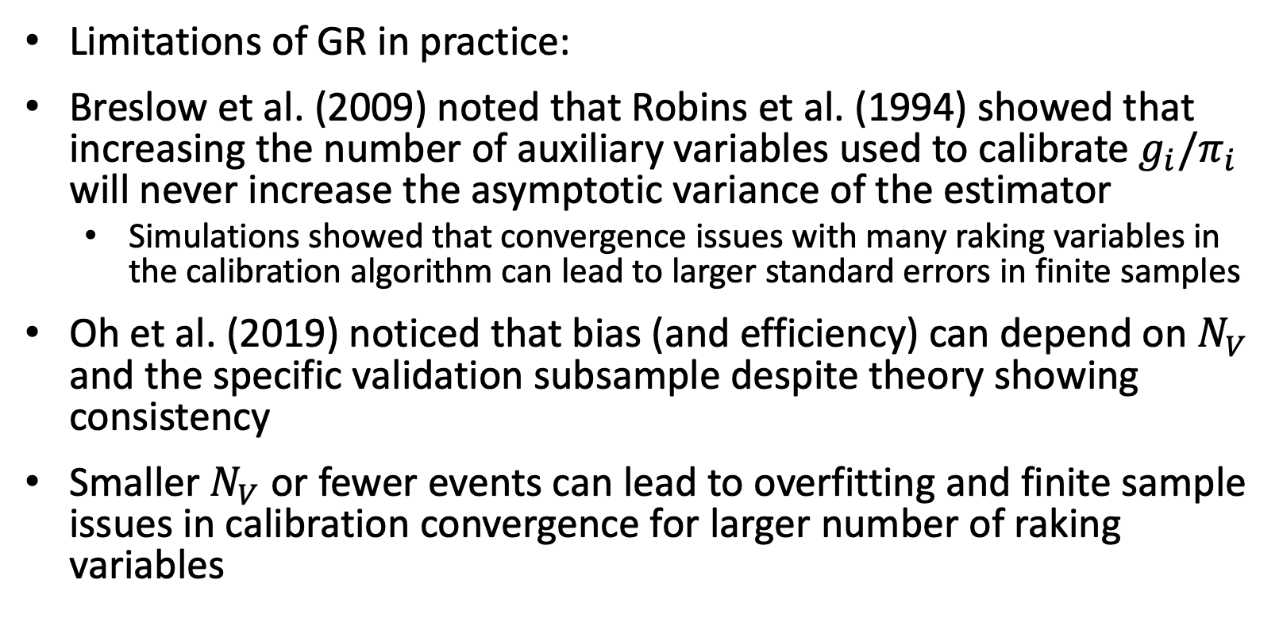
Section 2: Statistical methods for measurement error correction – improved estimation and inference
2.3 Generalized raking (GR)
Limitations of GR in practice:
Breslow et al. (2009) noted that Robins et al. (1994) showed that increasing the number of auxiliary variables used to calibrate $g_{i}/π_{i}$ will never increase the asymptotic variance of the estimator
Simulations showed that convergence issues with many raking variables in the calibration algorithm can lead to larger standard errors in finite samples
Oh et al. (2019) noticed that bias (and efficiency) can depend on $N_{V}$ and the specific validation subsample despite theory showing consistency
Smaller $N_{V}$ or fewer events can lead to overfitting and finite sample issues in calibration convergence for larger number of raking variables
Notes:
Lumley, T. (2010) Complex surveys. Hoboken: John Wiley & Sons, Inc.
Deville JC, Särndal CE. Calibration estimators in survey sampling. J Am Stat Assoc. 1992;87(418):376–382.

Slide 43
Section 3: Kaposi’s sarcoma in HIV clinic databases Application and complexities.

Slide 44
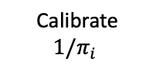
Section 3: Kaposi’s sarcoma in HIV clinic databases - application and complexities
3.1 KS study workflow
Complexities arose in practice
~270,000 patients in phase I with thousands of missing CD4 values
~1,000 patients in phase II with hundreds of missing CD4 values
Error prone inclusion criteria and outcome: enrollment date, death date, KS indictor
Workflow for GR iterates this process for each imputed dataset
Combine phase I and phase II data
Impute date variables
Observed CD4 values are added to patient-months
Impute indicator for whether patients with error-prone KS remain in the study
Expand dataset from patient to patient–months with imputed dates
Impute for phase I and phase II CD4
Impute covariates & impute KS indicator
Calculate IFs from fully MI datasets
Iteratively solve the weighted score functions
survey package in R
Impute death indicator
Calibrate ${1/π}_{i}$

Slide 45
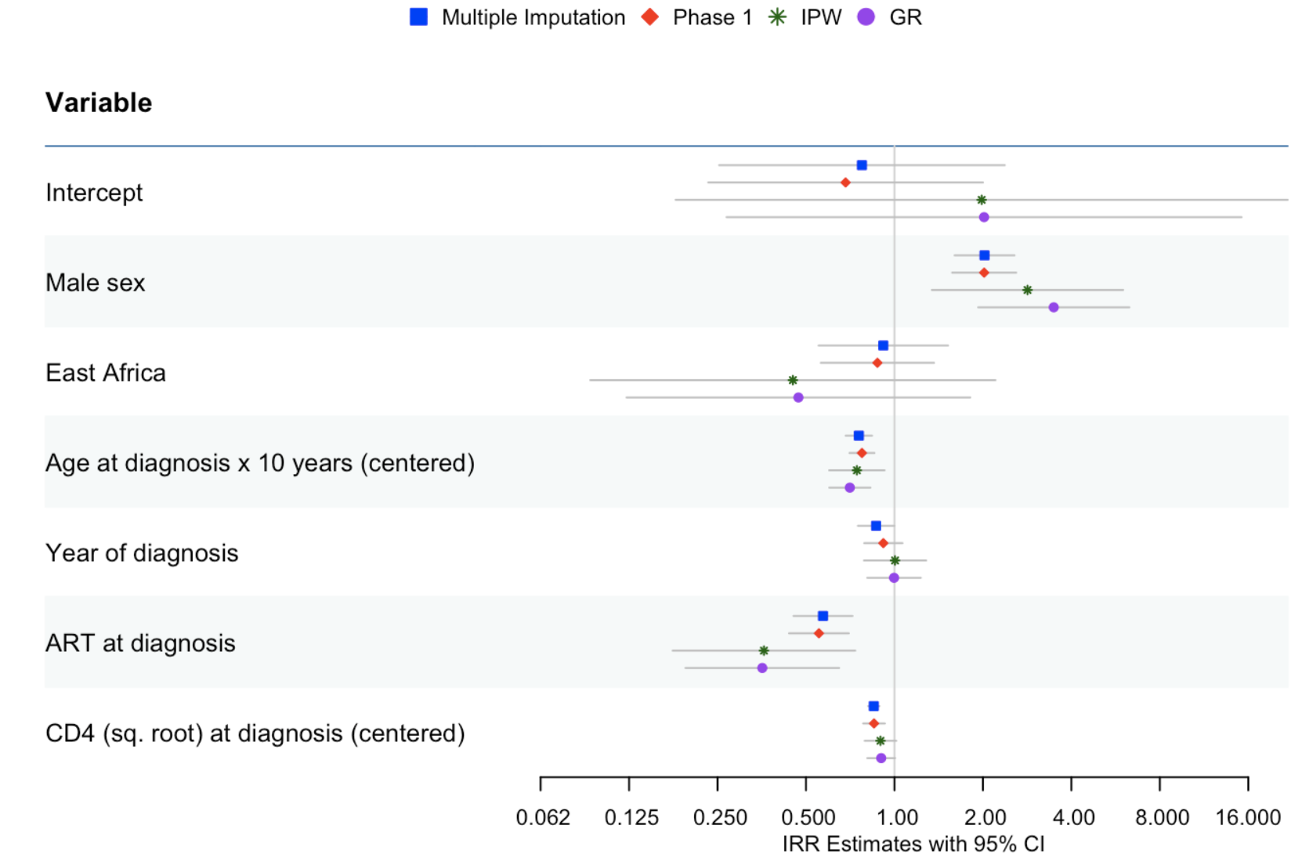
Section 3: Kaposi’s sarcoma in HIV clinic databases - application and complexities
3.2 Example results for incidence of KS (in progress)

Slide 46
Section 3: Kaposi’s sarcoma in HIV clinic databases - application and complexities
3.3 Discussion and next steps for the KS analysis
Conclusions may differ based on the choice of analysis when using error-prone routinely collected data
Assumptions of these methods differ and should be carefully considered
MI or GR methods recognize data quality uncertainty and incorporate error-prone data to improve efficiency
Use restricted cubic splines for continuous predictors
Continue thinking about issues with eligibility criteria by analysis

Slide 47
Section 4: Future work Issues in eligibility criteria.

Slide 48
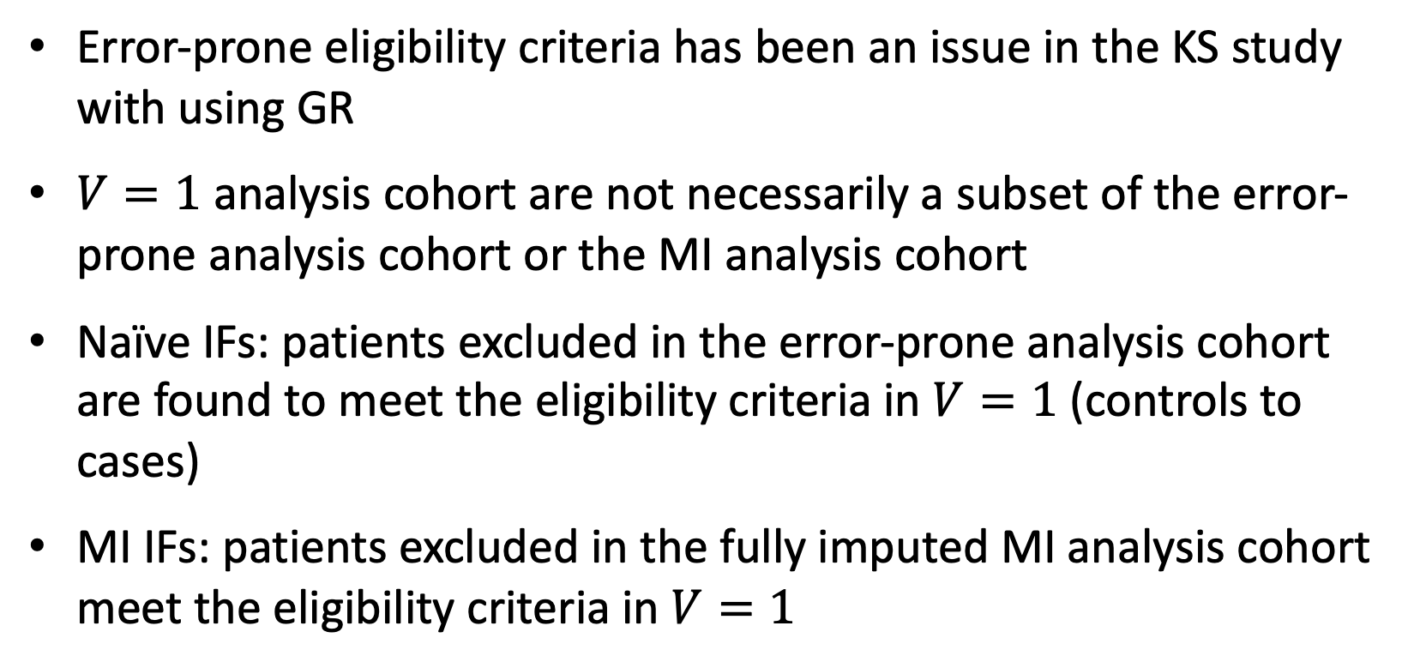
Section 4: Future work - issues in eligibility criteria
4.1 Future work
Error-prone eligibility criteria has been an issue in the KS study with using GR
$V=1$ analysis cohort are not necessarily a subset of the error-prone analysis cohort or the MI analysis cohort
Naïve IFs: patients excluded in the error-prone analysis cohort are found to meet the eligibility criteria in $V=1$ (controls to cases)
MI IFs: patients excluded in the fully imputed MI analysis cohort meet the eligibility criteria in $V=1$

Slide 49
Section 4: Future work - issues in eligibility criteria
4.1 Future work
Explore the GR estimator in the setting of error-prone eligibility criteria
Simulation study to understand the impact of differing levels of PPV and NPV
Study differences in performance between using the average of the IFs from MI datasets and combining the GR estimates from MI datasets IFs
Study these issues to compare the performance of naïve IFs vs. MI IFs in GR

Slide 50


Questions?

Slide 51
References
Amorim G, Tao R, Lotspeich S, Shaw PA, Lumley T, Shepherd BE. Two-Phase Sampling Designs for Data Validation in Settings with Covariate Measurement Error and Continuous Outcome. J R Stat Soc Ser A Stat Soc. 2021 Oct;184(4):1368-1389. doi: 10.1111/rssa.12689. Epub 2021 Apr 15. PMID: 34975235; PMCID: PMC8715909.
Binder DA. On the variances of asymptotically normal estimators from complex surveys. International Statistical Review. Published online 1983. doi:10.2307/1402588
Binder DA. Fitting Cox’s proportional hazards models from survey data. Biometrika. Published online 1992. doi:10.1093/biomet/79.1.139
Breslow NE, Lumley T, Ballantyne CM, Chambless LE, Kulich M. Using the whole cohort in the analysis of case-cohort data. Am J Epidemiol. 2009 Jun 1;169(11):1398-405. doi: 10.1093/aje/kwp055. Epub 2009 Apr 8. PMID: 19357328; PMCID: PMC2768499.
Cole SR, Chu H, Greenland S. Multiple-imputation for measurement-error correction. International Journal of Epidemiology. Published online 2006. doi:10.1093/ije/dyl097
Deville JC, Särndal CE. Calibration estimators in survey sampling. J Am Stat Assoc. 1992;87(418):376–382.
Duda, S. N., Shepherd, B. E., Gadd, C. S., Masys, D. R., and McGowan, C. C. (2012). Measuring the Quality of Observational Study Data in an International HIV Research Network. PLoS One. 7(4): e33908. DOI: 10.1371/journal.pone.0033908.
Edwards JK, Cole SR, Troester MA, Richardson DB. Accounting for Misclassified Outcomes in Binary Regression Models Using Multiple Imputation With Internal Validation Data. American Journal of Epidemiology. Published online 2013. doi:10.1093/aje/kws340
Giganti, M. J., Shepherd, B. E., Caro-Vega, Y., Luz, P. M., Rebeiro, P. F., Maia, M., Julmiste, G., Cortes, C., McGowan, C. C. and Duda, S. N. (2019), The impact of data quality and source data verification on epidemiologic inference: a practical application using HIV observational data, BMC Public Health 19(1), 1748.
Giganti MJ, Shaw PA, Chen G, Bebawy SS, Turner MM, Sterling TR, Shepherd BE. ACCOUNTING FOR DEPENDENT ERRORS IN PREDICTORS AND TIME-TO-EVENT OUTCOMES USING ELECTRONIC HEALTH RECORDS, VALIDATION SAMPLES, AND MULTIPLE IMPUTATION. Ann Appl Stat. 2020 Jun;14(2):1045-1061. doi: 10.1214/20-aoas1343. Epub 2020 Jun 29. PMID: 32999698; PMCID: PMC7523695.
Giganti MJ, Shepherd BE. Multiple-Imputation Variance Estimation in Studies With Missing or Misclassified Inclusion Criteria. Am J Epidemiol. 2020 Dec 1;189(12):1628-1632. doi: 10.1093/aje/kwaa153. PMID: 32685964; PMCID: PMC7705600.

Slide 52
References
Han P. Combining inverse probability weighting and multiple imputation to improve robustness of estimation. Scandinavian Journal of Statistics. 2016;43(1):246-260. doi:10.1111/sjos.12177
Horvitz DG, Thompson DJ. A generalization of sampling without replacement from a fi- nite universe. Journal of the American Statistical Association. Published online 1952. doi:10.1080/01621459.1952.10483446
Keogh, R. H., Shaw, P. A., Gustafson, P., Carroll, R. J., Deffner, V., Dodd, K. W., Küchenhoff, H., Tooze, J. A., Wallace, M. P., Kipnis, V. and Freedman, L. S. (2020), STRATOS guidance document on measurement error and misclassification of variables in observational epidemiology: Part 1—Basic theory and simple methods of adjustment, Statistics in Medicine 39(16), 2197–2231.
Kiragga AN, Castelnuovo B, Schaefer P, Muwonge T, Easterbrook PJ. Quality of data collection in a large HIV observational clinic database in sub-Saharan Africa: implications for clinical research and audit of care. J Int AIDS Soc. 2011 Jan 20;14:3. doi: 10.1186/1758-2652-14-3. PMID: 21251327; PMCID: PMC3037294.
Little RJ, Rubin DB. Statistical Analysis with Missing Data. 3rd Edition. Wiley, New York, 2002.
Lotspeich SC, Giganti MJ, Maia M, Vieira R, Machado DM, Succi RC, Ribeiro S, Pereira MS, Rodriguez MF, Julmiste G, Luque MT, Caro-Vega Y, Mejia F, Shepherd BE, McGowan CC, Duda SN. Self-audits as alternatives to travel-audits for improving data quality in the Caribbean, Central and South America network for HIV epidemiology. J Clin Transl Sci. 2019 Dec 26;4(2):125-132. doi: 10.1017/cts.2019.442. PMID: 32313702; PMCID: PMC7159809.
Lumley, T. (2010). Complex Surveys: A Guide to Analysis Using R. John Wiley and Sons.
Lumley T, Shaw PA, Dai JY. Connections between Survey Calibration Estimators and Semipara- metric Models for Incomplete Data. International Statistical Review. Published online 2011. doi:10.1111/j.1751-5823.2011.00138.x
Lumley T, Scott A. Fitting Regression Models to Survey Data. Statistical Science. Published online 2017. doi:10.1214/16-sts605
Messer K, Natarajan L. Maximum likelihood, multiple imputation and regression calibration for measurement error adjustment. Statistics in Medicine. Published online 2008. doi:10.1002/sim.3458

Slide 53
References
Mphatswe W, Mate KS, Bennett B, Ngidi H, Reddy J, Barker PM, Rollins N. Improving public health information: a data quality intervention in KwaZulu-Natal, South Africa. Bull World Health Organ. 2012 Mar 1;90(3):176-82. doi: 10.2471/BLT.11.092759. Epub 2011 Dec 5. PMID: 22461712; PMCID: PMC3314204.
Neyman J. On the Two Dierent Aspects of the Representative Method: The Method of Stratified Sampling and the Method of Purposive Selection. Journal of the Royal Statistical Society. Published online 1934. doi:10.1007/978-1-4612-4380-9_12
Oh EJ, Shepherd BE, Lumley T, Shaw PA. Raking and Regression Calibration: Methods to Address Bias from Correlated Covariate and Time-to-Event Error. Statistics in Medicine. Published online 2019. doi:10.1002/sim.8793
Oh E, Shepherd BE, Lumley T, Shaw PA. Improved Generalized Raking Estimators to Address Dependent Covariate and Failure-Time Outcome Error. Biometrical journal Biometrische Zeitschrift. Published online 2020. doi:10.1002/bimj.202000187
Robins, James M., and Naisyin Wang. “Inference for Imputation Estimators.” Biometrika, vol. 87, no. 1, 2000, pp. 113–24. JSTOR, http://www.jstor.org/stable/2673565. Accessed 23 Jan. 2024.
Robins, James M., et al. “Estimation of Regression Coefficients When Some Regressors Are Not Always Observed.” Journal of the American Statistical Association, vol. 89, no. 427, 1994, pp. 846–66. JSTOR, https://doi.org/10.2307/2290910. Accessed 21 Jan. 2024.
Shepherd BE, Shaw PA, Dodd LE. Using audit information to adjust parameter estimates for data errors in clinical trials. Clinical Trials. Published online 2012. doi:10.1177/1740774512450100

